Slide 1
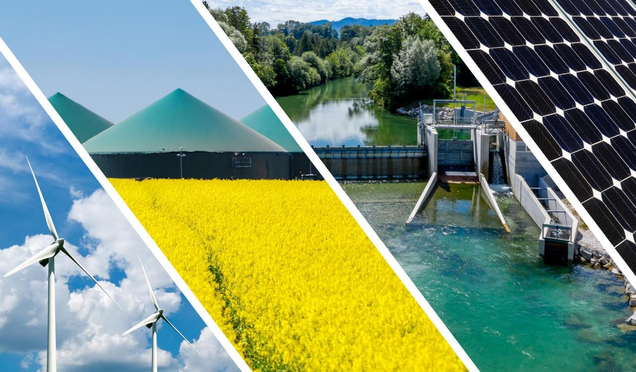
Europe needs a new speed in deploying renewables: Implementation is key
23rd Inter-Parliamentary Meeting on Renewable Energy and Energy Efficiency (IPM23) 27 October 2023
Rainer Hinrichs-Rahlwes Vice-President rainer.hinrichs@bee-ev.de
twitter.com/EREFEU linkedin.com/company/erefeu info@eref-europe.org

Slide 2
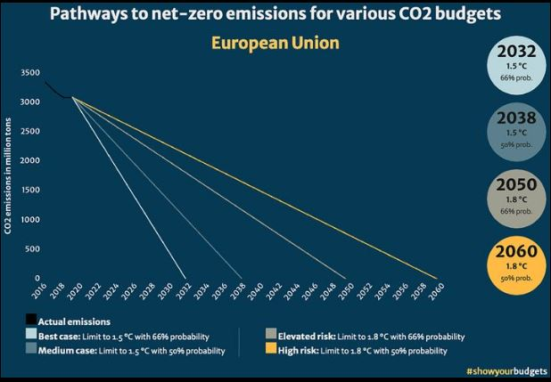
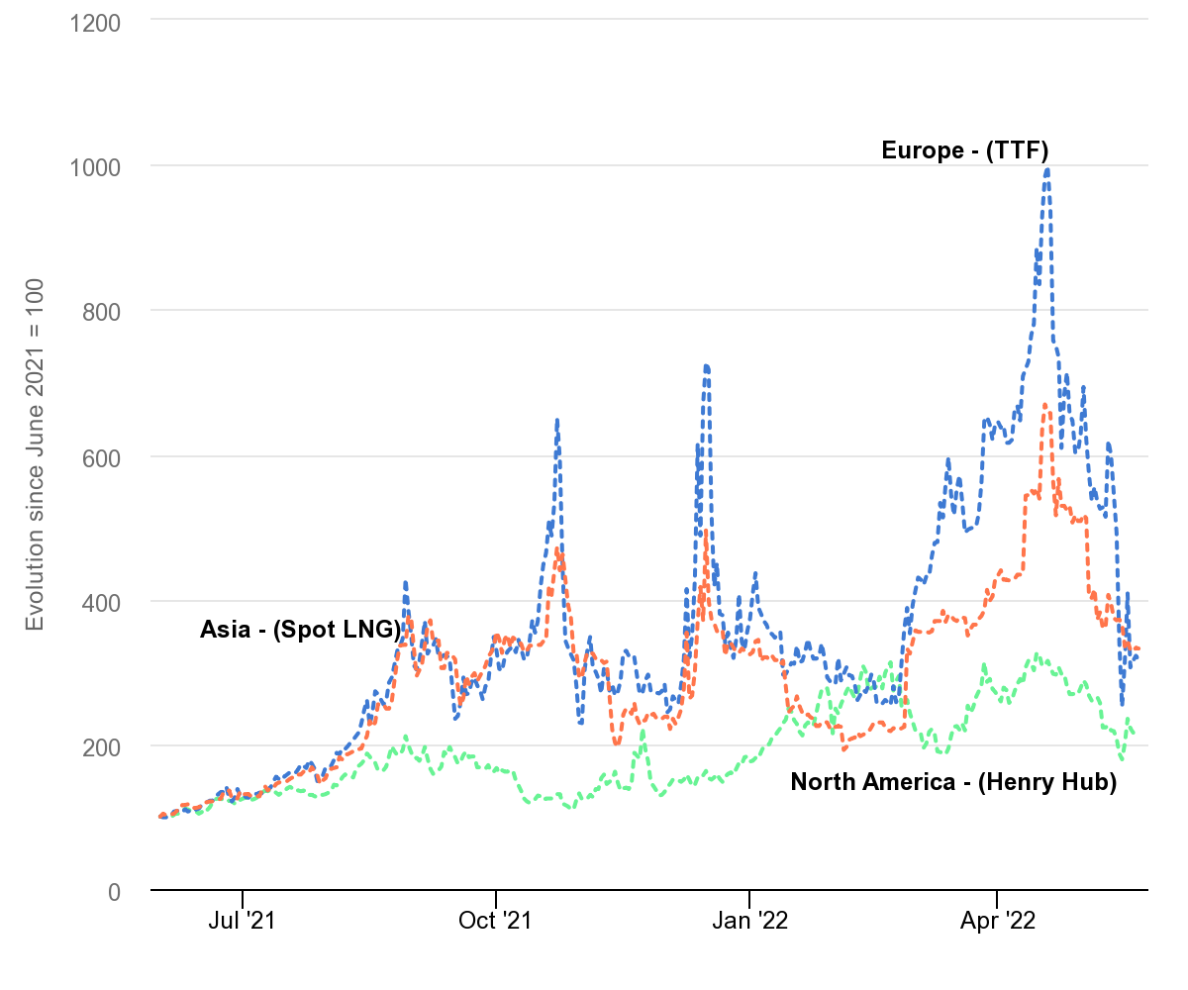
Urgency to decarbonise well before 2050
Climate change is happening much faster than expected
Increasing energy security by reducing imports of fossil and nuclear energy sources
Getting independent from price spikes of fossil fuels
Source: showyourbudgets / CC BY 4.0
The evolution of key regional natural gas prices, June 2021-October 2022

Slide 3
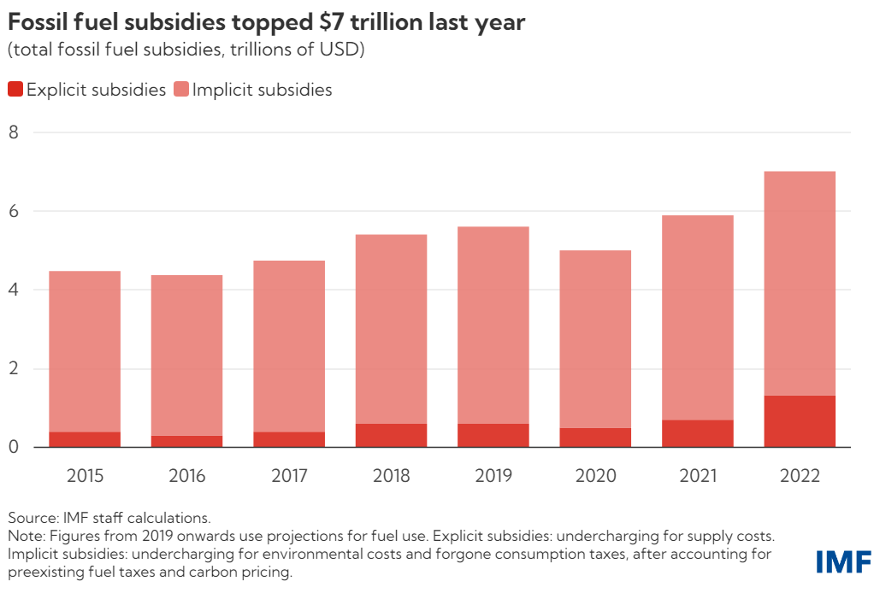
Phase out of fossil energy sources is necessary
Main barriers to decarbonization:
Biased market conditions in favour of fossil fuels
Increasing (!) subsidies
IMF Blog, 24 August 2023: Fossil Fuel Subsidies Surged to Record $7 Trillion (imf.org)

Slide 4
Decarbonisation: using all available RE technologies
It is doable: various scenarios to fully decarbonize the EU, some with 100% RE
Technologies exist. They are local and affordable! Often lowest cost option.
Heat pumps (incl. geothermal heat pumps)
District heating (incl. geothermal district heating and cooling systems)
Solar Thermal
Direct electric heating with RE (using all available sources)
Biomass, incl. biogas/biomethane
Green hydrogen and derivates

Slide 5
Promote geothermal – together with Heat Pumps
Proposed Heat Pump Accelerator should include support for deployment of Geothermal Heat Pumps (GHPs) in buildings, district heating and cooling systems, industry
Provide permitting rules for a fast role out of geothermal (similar to those in EU Solar Strategy)
Provide an EU-wide financial risk mitigation framework
Create strong regulations, guidelines, and incentives to phase out fossil heating

Slide 6
Role of bioenergy
Bioenergy offers climate protection where other technologies are limited
Secured, controllable output to supplement variable renewable sources
High temperature levels for heating grids & industrial process heat
Mobility options where full/direct electrification is not (yet) possible (including for existing vehicle fleets)
Building blocks for a green gas economy (biomethane, biogenic H2).
CO2 removal from the air and permanent storage
Bioenergy allows for climate protection together with nature conservation in agriculture and forestry

Slide 7
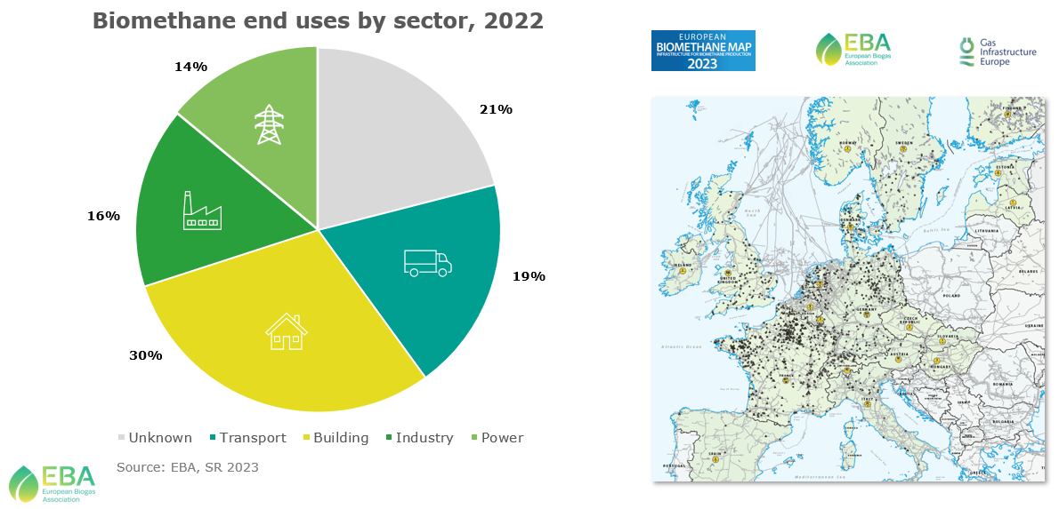
Today’s use of biomethane

Slide 8
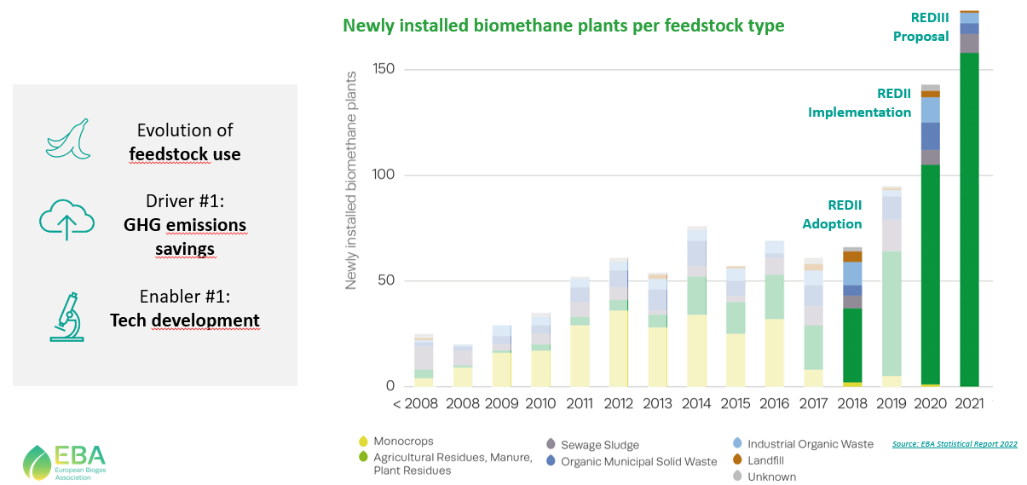
EU’s biomethane is produced from sustainable feedstocks

Slide 9
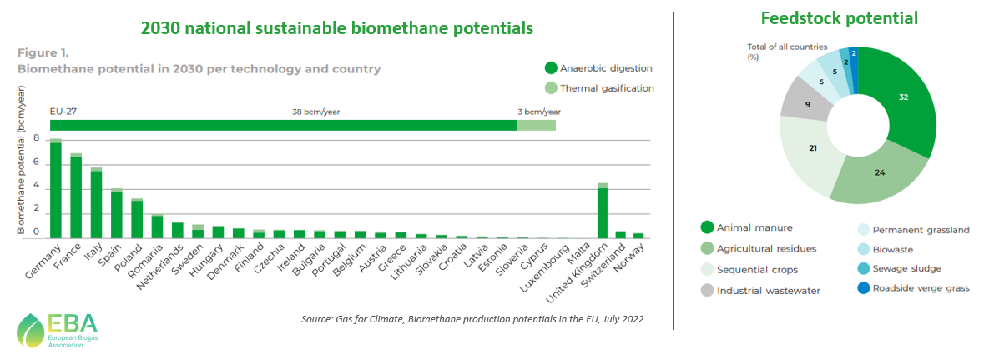
EU27’s production potential can meet the REPowerEU target

Slide 10
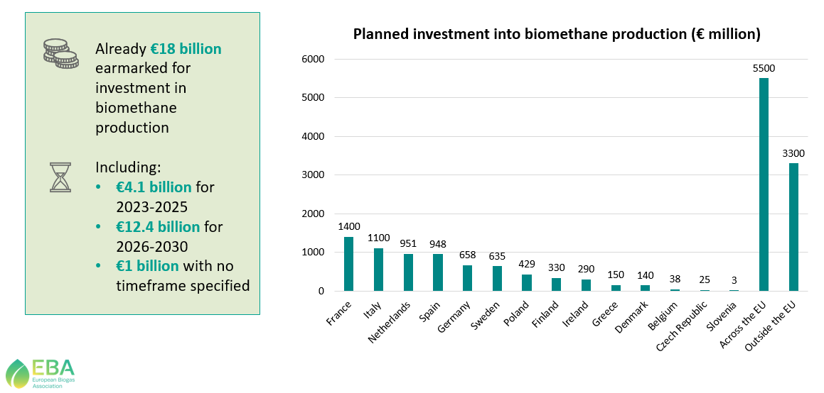
EBA Biomethane Investment Outlook (May 2023)

Slide 11
Accelerate biomethane injection into the gas grid
Acceleration of planning, approval and construction (esp. privileging of biogas)
Simplified approval procedures
Binding time limit for realization of network access & information processing at the municipal level
Introduction of a financial support program for the conversion of existing installations
Sharing of investment costs for new heating systems between landlords and tenants
Biomethane use for power production to be shifted from peak load power plants without heat extraction towards flexible and highly efficient combined heat and power (CHP) plants

Slide 12
Next steps and what needs to be done …
IMPLEMENTATION of EU Green Deal (Fit-for-55, REPowerEU …) is key!
Support for national and local level (decision makers, local/regional authorities)
Mix of ALL available RENEWABLE energy technologies needed.
End date for PHASING OUT COAL is needed – also for FOSSIL GAS.
End of all related subsidies should be agreed NOW.
2040 targets (90% plus GHG reduction) and enabling legislation to be agreed soon after EP elections: together with nationally binding RENEWBLE ENERGY and EFFICIENCY TARGETS
Maintain and strengthen EUROPEAN production capacities for RE and EE technologies along the value chain (NZIA, CRMA, skills initiatives, etc.)
Notes:
To summarize, despite some success, there is still a lot to do to accelate the EU‘s decarbonisaion efforts
At national and local level: implementation of EU law
At EU level: steps for the time after 2030, namely … (see slide)

Slide 13
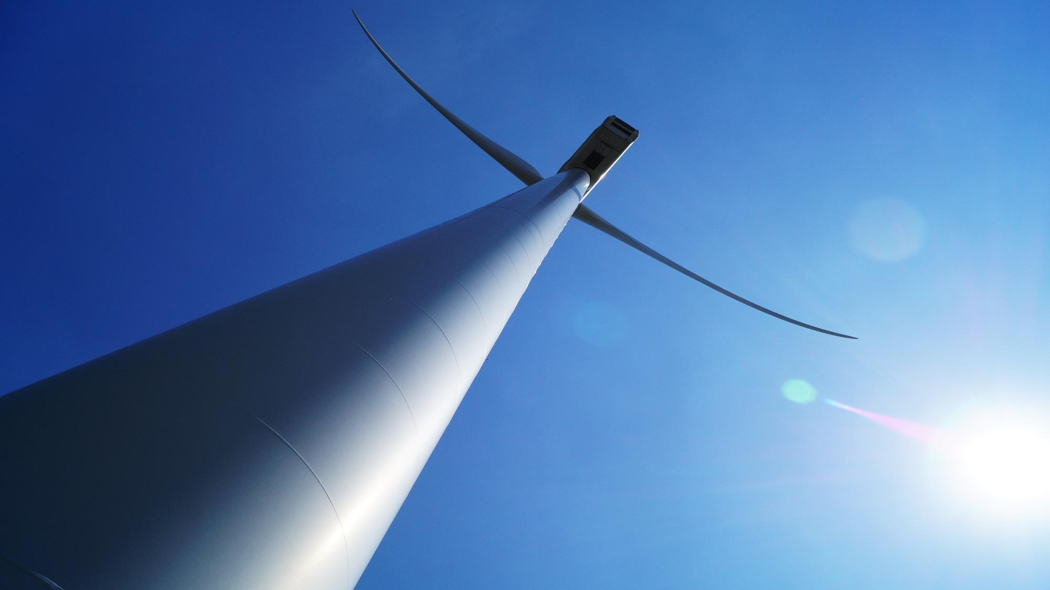
Thank You for Your Attention
Dirk Hendricks Secretary General dirk.hendricks@eref-europe.org
twitter.com/EREFEU linkedin.com/company/erefeu info@eref-europe.org

