Slide 1


Why Economic and National Security Focus on Energy supports Europe’s Strategic Autonomy, the Green Transformation and a Stronger Role in the World

Slide 2
ABOUT SAFE & the EUROPEAN INITIATIVE FOR ENERGY SECURITY
SAFE is an action-oriented, non-party organization committed to transportation, energy, and supply chain policies that advance the economic and national security of the United States, its allies and partners. SAFE has convened business and former military leaders since 2004 to advocate for secure, resilient, and sustainable energy solutions.
The European Initiative for Energy Security (EIES), in collaboration with its Energy Security Leadership Council – Europe (ESLC-Europe) brings a pragmatic perspective – centred on energy and economic security – to accelerate Europe’s clean energy transition.

Slide 3





SAFE’S HISTORY
2004
2006
2009
2015
2018
2021
2023

Slide 4
ABOUT EIES
EIES will define a new economic “strategic autonomy” for Europe, establishing and strengthening public and political support for solutions that:
strengthen international – and transatlantic – cooperation, collaboration, and alliances, to achieve mutual goals in the most resource-efficient manner;
address European energy security, mitigate energy crises and energy poverty, and provide reliable mid-transition energy policies;
diversify energy supply chains;
rebuild the domestic industrial base to the highest standards possible; and
lessen dependencies on unfriendly and authoritarian trading partners, and non-secure supply chains that do not represent European values, ideals, and environmental standards.

Slide 5

SAFE’S TRACK RECORD
Turned fuel economy from environmental into a national security issue resulting in the Energy Independence and Security Act of 2007 which raised fuel economy for the first time in 30-years and the first time for trucks.
Before EVs went mainstream, released two groundbreaking policy documents – Electrification Roadmap and Fleet Electrification Roadmap – that explained reasons for government choosing EVs and pathway to adoption.
SAFE hosted National Summit on Energy Security, OPEC +40, and SAFE Summit 2023: A Pathway to Electrification from Minerals to Markets. Upcoming summit is SAFE Summit 2024: The Global Power Puzzle.
Mentioned in two States of the Union by Presidents George W. Bush and Barack Obama.
Helped write and pass EV Tax Credit creation in 2009 and drove reform in 2022.
Helped broker the Inflation Reduction Act 0f 2022 with Senator Manchin promoting supply chain provisions and major policy initiatives added to the Bipartisan Infrastructure Bill and the CHIPs Act.
Defined an All of the Above policy that defied ideology and helped turn the U.S. into an energy powerhouse.

Slide 6
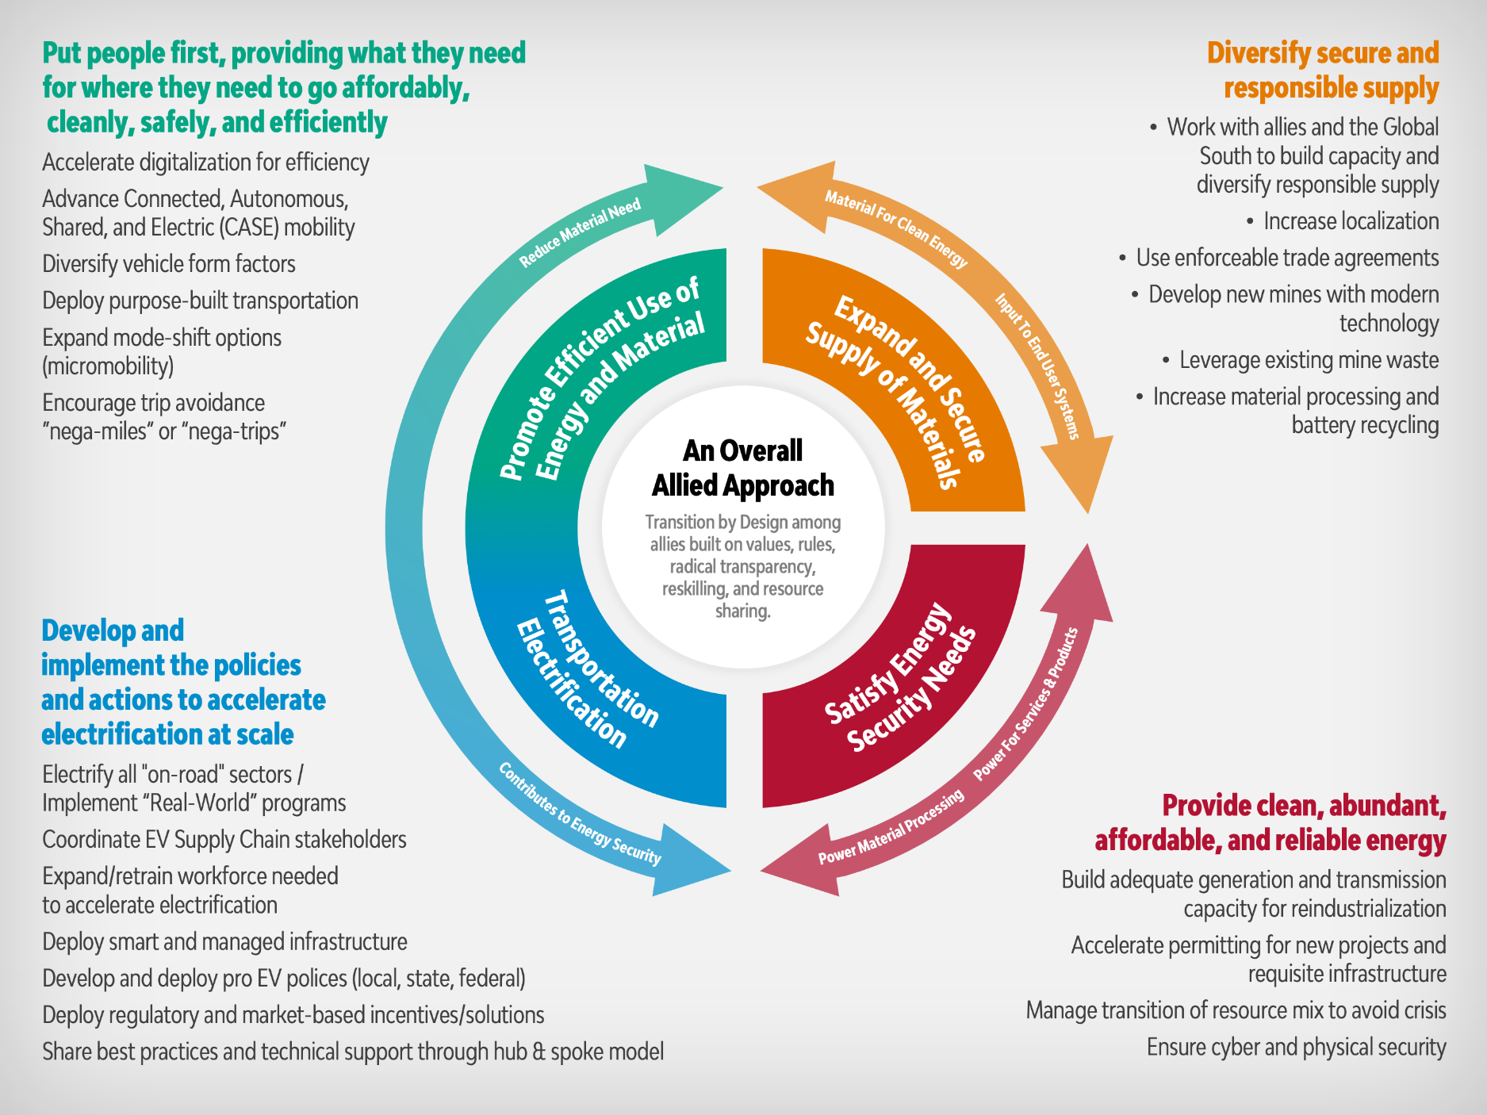
SAFE IS TAKING A SYSTEMS APPROACH

Slide 7
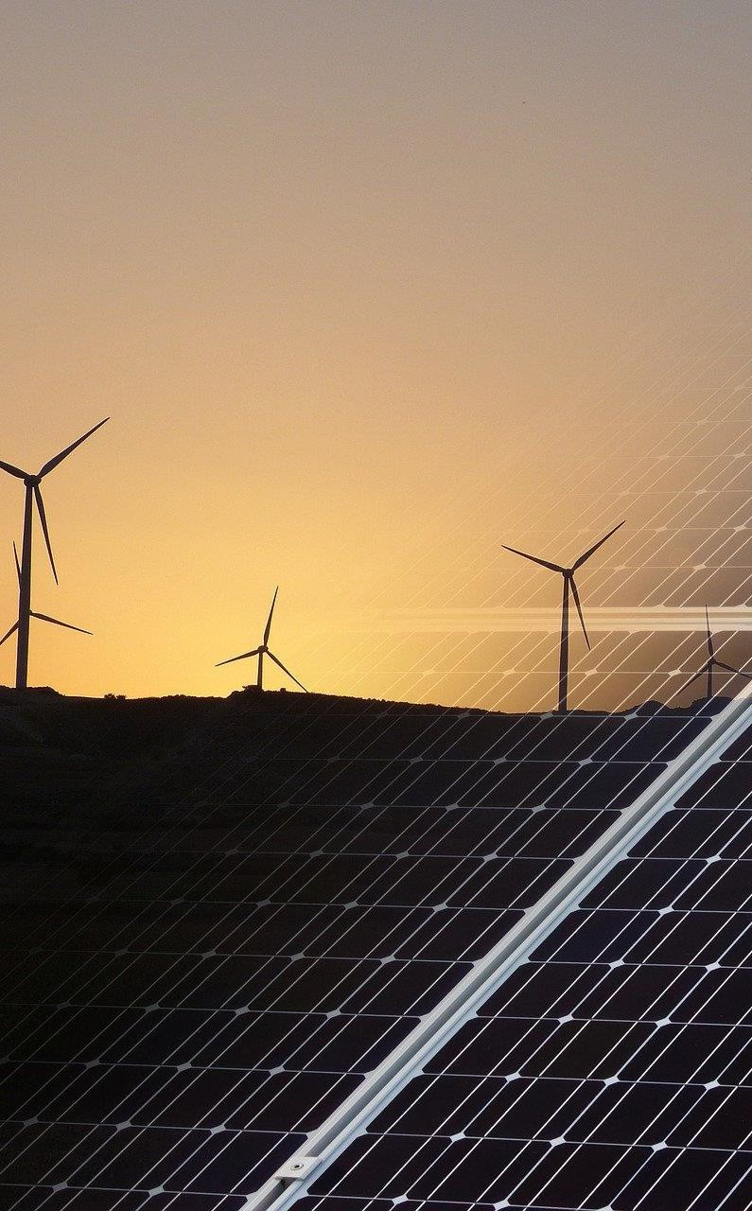
EUROPE’S POLYCRISIS
Russia’s illegal invasion of Ukraine: compromising security, growth, energy transition:
National security: Europe’s overreliance on Russian gas has limited its ability to promote its interests and values
Economic security: households - 10% of Europeans unable to keep their homes warm – and public budgets
Climate security: resorting to higher-polluting natural resources
Supply chain security: Europe remains critically dependent on China and other hostile actors

Slide 8

CRISIS LESSONS: SOME STILL UNLEARNED
In response to drop in Russian pipeline gas imports, Europe demonstrated an impressive ability to coordinate and mobilize. Yet, several key lessons we’re not getting right:
Europe continuing to fuel Moscow’s War
Continued erosion of industry, with limited emergence of new domestic supply chains
Enduring supply chain dependency on China, limiting Europe’s ability to act geopolitically
Lacking transatlantic cooperation
Cost-of-Living crisis threat to social cohesion and democracy
Still no pan-European security strategy

Slide 9
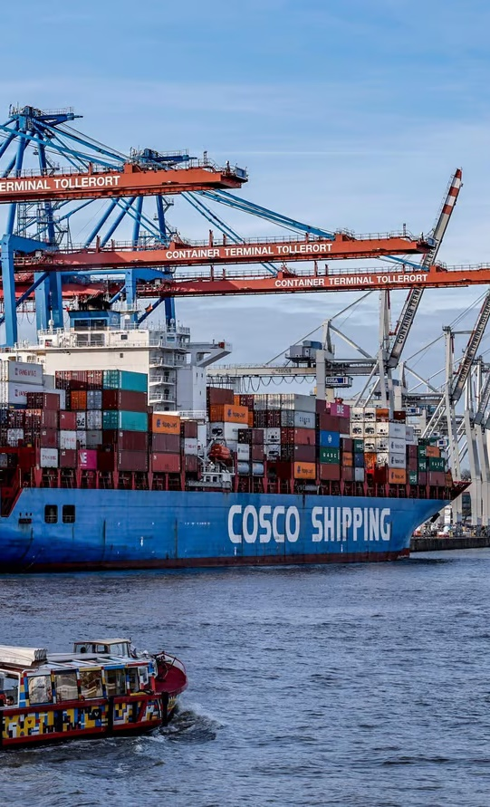
THE CHANGING POWER PUZZLE
Europe at forefront of global energy transition
Implications of energy transition:
          Localized new geographies of energy and industry
                New capital inputs: minerals
                Grid reliability and new connectivity needs
                Mid-transition: abrupt action could jolt economies, need for low-emissions sources
Rising China: dominates many critical supply chains, dumping (PV & EVs), export bans (graphite).
Balancing Transatlantic Competitiveness and Cooperation: pressure to compete with U.S. IRA.

Slide 10
PRODUCTION OF CRITICAL RAW MATERIALS IS HIGHLY CONCENTRATED
Top Oil vs. Critical Raw Material Producers, 2022
Critical raw materials are not found in isolation. Various processing and refining steps are needed to separate critical raw materials from mined ore.
Most minerals that are mined today will unavoidably end up in China for processing and refining into useable materials.
If this trend continues, policymakers on both sides of the Atlantic should worry about trading reliance on oil for dependence on minerals controlled by China.
Other
Countries
China
Canada
U.S.
OPEC+
OPEC
Source: SAFE analysis based on data from U.S. Energy Information Agency and Benchmark Mineral Intelligence.

Slide 11
WHAT DOES AN ALLIED SUPPLY CHAIN LOOK LIKE?
 | Lithium (Li) | Nickel (Ni) | Cobalt (Co) | Manganese (Mn) | Graphite (C)
Top Reserves | Chile (#1, 42%) | Australia (#1, 22%) | Australia (#2, 18%) | Australia (#2, 18%) | Turkey (#1, 28%)
Top Reserves | Australia (#2, 26%) | Brazil (#3, 17%) | Philippines (#5, 3.4%) | Brazil (#2, 18%) | Brazil (#3, 22%)
Top Reserves | Argentina (#3, 10%) | Philippines (#5, 5%) | Canada (#7, 2.9%) | Mexico (#9, 0.3%) | Mexico (#9, 1%)
Top Producer | Australia (#1, 55%) | Philippines (#2, 14%) | Australia (#3, 3.3%) | Australia (#3, 17%) | Brazil (#2, 6.8%)
Top Producer | Chile (#2, 26%) | Australia (#5, 6%) | Philippines (#4, 2.6%) | Brazil (#9, 2%) | Norway (#7, 1.3%)
Top Producer | Argentina (#4, 6.2%) | Canada (#6, 4.8%) | Canada (#5, 2.5%) | Mexico (#12, 1%) | Canada (#9, 0.9%)
Top Processor | Chile (#2, 30%) | EU (#2, 10%) | EU (#2, 15%) | EU (#2, 5%)
Top Processor | Argentina (#3, 6.2%) | Japan (#4, 4.5%) | Canada (#3, 3.5%)
Top Processor | U.S. (#4, 4%) | South Korea (#5, 4.4%) | Japan (#4, 2.3%)
Highlighting countries with which the U.S. has an FTA or a major alliance (NATO or Major Non-NATO Ally).
Data from the U.S. Geological Survey 2022 Mineral Commodity Summary and Benchmark Mineral Intelligence

Slide 12
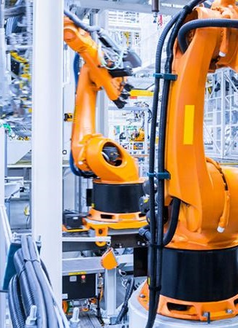
AN OPEN EUROPEAN STRATEGIC AUTONOMY
Need to deliver industrial capacity to strengthen socio-economic model
Prioritize strategic dual purpose supply chains: green technology, information technology, aerospace, defence
Compete beyond cost, setting high standards and rules that reflect our values and priorities
Work with friends and allies to strengthen transparent supply chains that deliver on green transition
Need financial mechanisms (beyond existing legislative packages) that can support a pan-European approach and play to Europe’s strengths (ex. Innovation Fund, Sovereignty Fund)

Slide 13
For more information, please contact
Jeppe Kofod, former Minister for Foreign Affairs (Denmark)
Jeppe@kofodglobal.com
Avery Ash, Senior Vice President of Government Affairs and Special Initiatives
aash@secureenergy.org

