Slide 1
Renewable energy in district heating in Zuid-Holland
Workshop EUFORES_EU
The European Green Deal and the National Energy and Climate Plan in The Netherlands
Dr. Annelies van Ewijk
am.van.ewijk@pzh.nl
8 december 2021

Slide 2
Presenting Zuid-Holland’s heat potential
Total energy use 430 PJ
Total heat use 130 PJ
(Built environment + Horticulture)
Potential 2030 (36% reduction)
Geothermal heat 30%
Industrial waste heat 30%
Solar thermal 13%
Aquathermal 7%
Electric heatpumps 20%
Lots of locally available sources!
Lots of work to match sources and demand
Rural area
Big Cities
Horticulture
Rural area
Large industry
Big Cities
Rural area

Slide 3
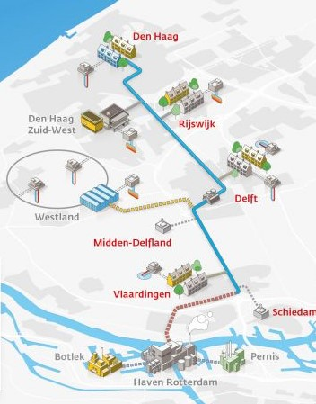
What are we doing
Developing sources, infra structure, insulation, heat demand, storage and innovation/knowledge
  Solar thermal: Regional potential study done, preparing pilot(s)
  WarmtelinQ(+): partner in developing regional heat infrastructure, usage of industrial waste heat
  Insulation programma for the built environment
  High Temperature Storage: 6 pilots → Learning by doing
  Geothermal: funding field lab Rijswijk Centre for Sustainable Geo-energy (RCSG) & 2 chairs at TU Delft
  Helping develop innovative solutions (mineral and other forms of heat storage)
  Supporting municipalities, strategy and vision development (RES, RSW, TVW)
  Developing a heat usage framework: clever use of sources for heat demand (Afwegingskader Warmte)
Partners: Gasunie, TNO, municipalities, BZK, EZK, EU/EIB, private companies
Unlocking financial funds: PAW, Elena, KvW, Groeifonds, RRF in
order to close businesscases
Updating our environmental policy to make it happen
Participating in clever sharing of energy in the area: Energierijk Den Haag
Supporting Local Initiatives for sources and local networks

Slide 4

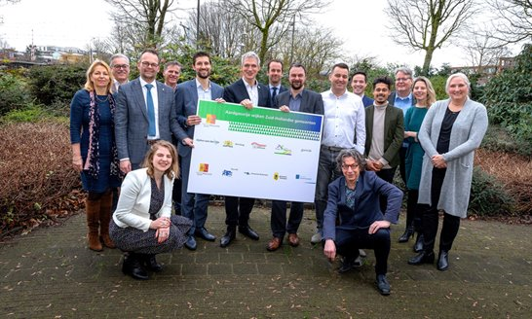
ELENA Programme with 9 municipalities

Slide 5

ELNA FUND for district heating in practice
ELENA: 2.7 mln. Euros subsidy from EIB and 0.3 mln. Euros from the province -> leads to investments up to 20x of the FUND = 60 mln. Euros within 3 years, 10 projects in Zuid-Holland.
ELENA is subsidy for the preparations or technical assistance in advance of the main investment.
It is a struggle to close business cases:
  Infrastructural investment mostly done by energy compagnies
  Investments in social housing must fit in plans of the housing companies
  High costs.
  It is difficult to persuade private individuals to invest in sustainable energy in their homes
Contact with all house owners in the neighbourhood is necessary for the support of the future heat supply.
Challenges have to be overcome within 3 years: deadline 30-9-2023.
Advantage of this project: Sharing knowledge and information between municipalities to speed up the transition.

Slide 6
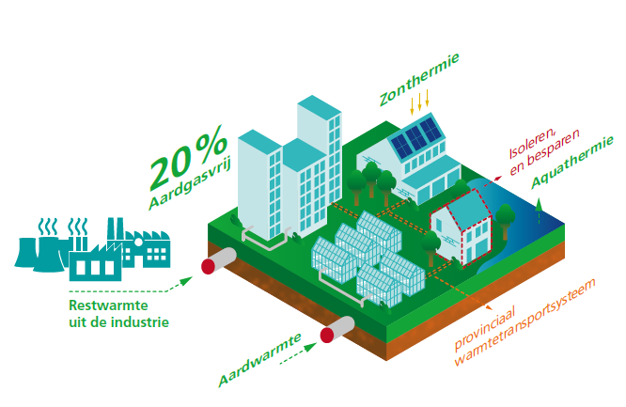
What is needed:
National government and EU as partner
We all want huge scale-up of the heat transition for the 2030 target
  Thermal grids are ‘no regret’ in 80% of the neighbourhoods and horticultural clusters in Z-H
Consistent urgency, policy statements and legislation from national government
More funding of energy infrastructure, including heat systems
Venture Capital and Human Capital
Legislative tools for provincial & local governments
Programming and investing with best knowledge
even though final best solution is still unknown
Province and municipalities cannot do this on their own.

