Slide 1
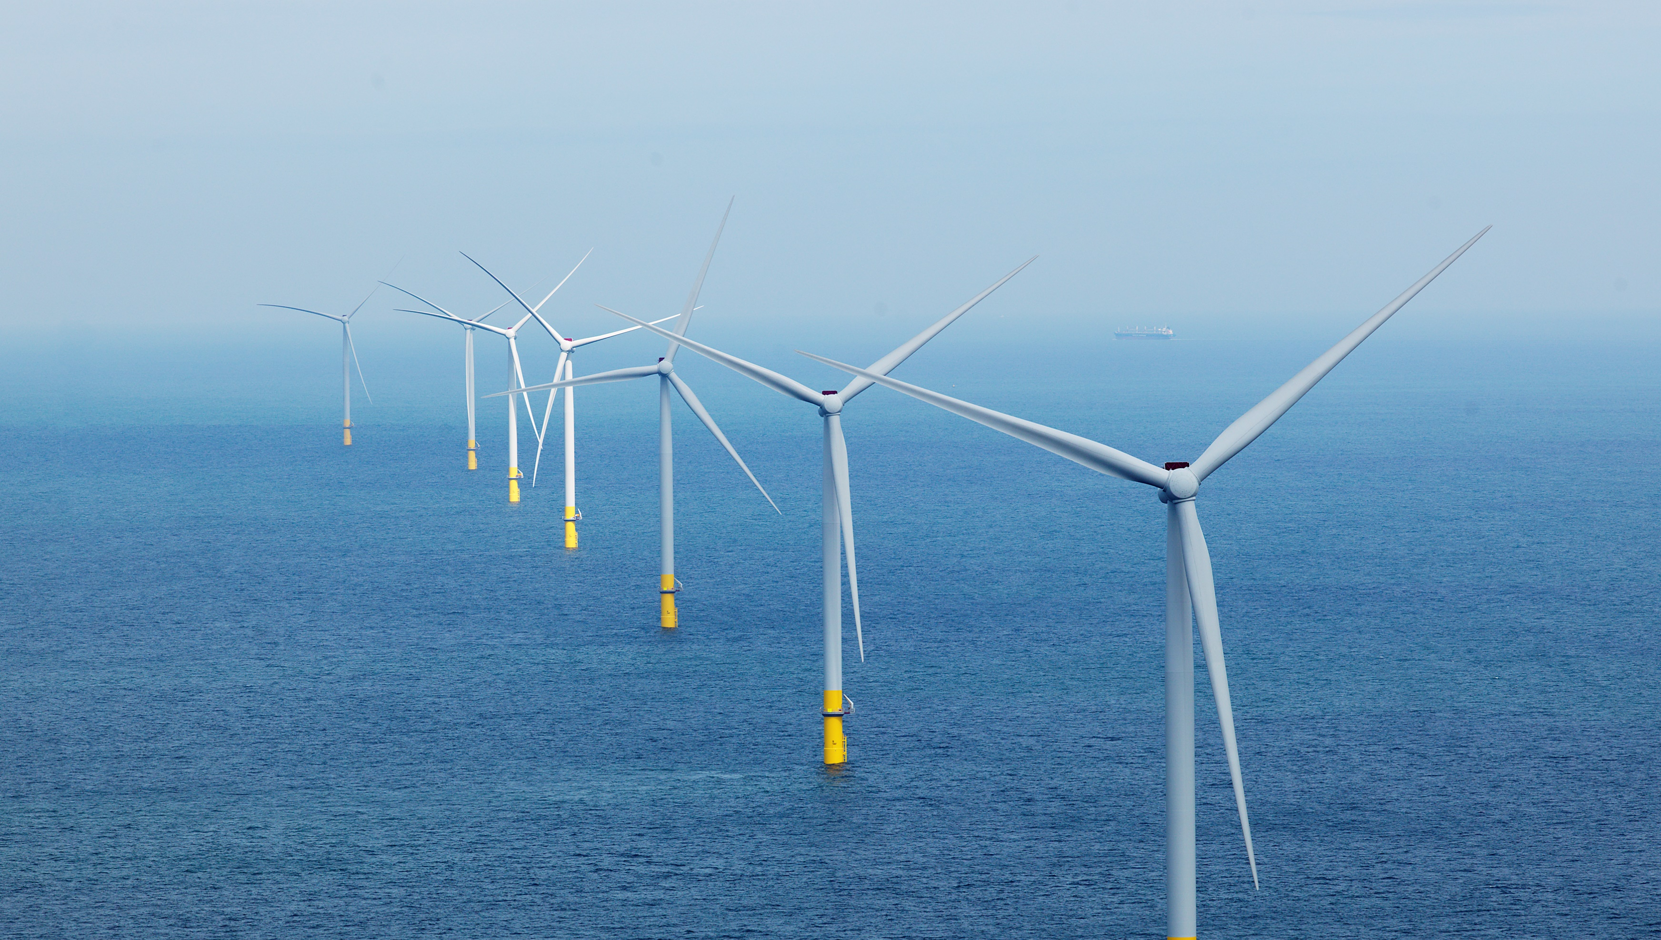
Eufores NL parliamentary workshop

Slide 2


Our vision
Let’s create a world that runs entirely on green energy

Slide 3
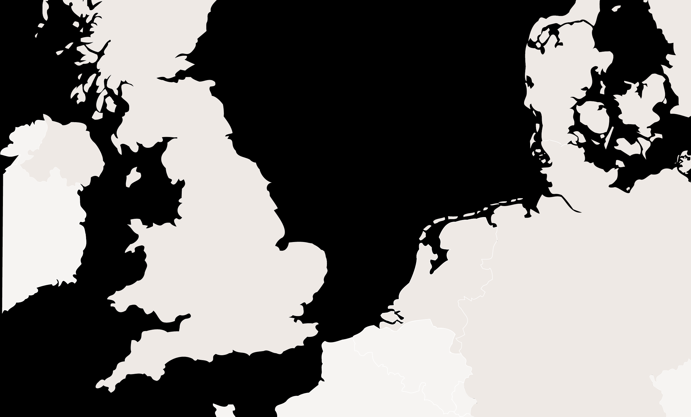
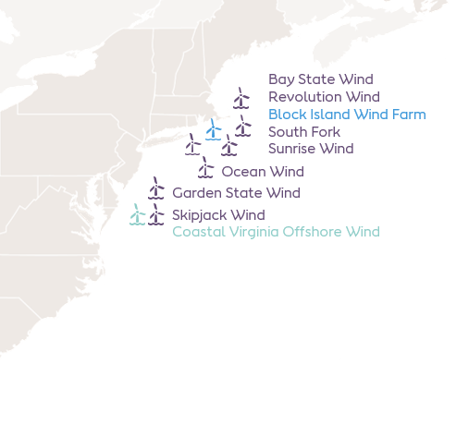
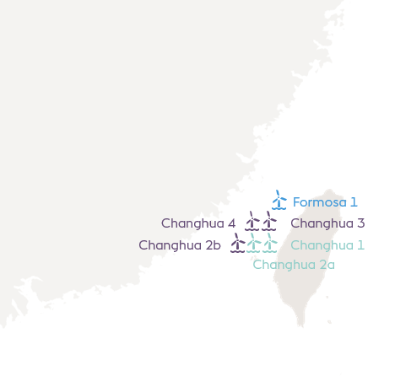
Ørsted – our offshore wind portfolio
Anholt
Denmark
H2RES
Horns Rev 1
Green Fuels for DK
Horns Rev 2
DFDS Green Ferry
Skåne
Nysted
USA
Isle of man
Westermost Rough
Gode Wind 1
Walney Extension
Gode Wind 2
Walney 1 & 2
Barrow
Hornsea 1
Gode Wind 3
West of Duddon Sands
Hornsea 2
Borkum Riffgrund 3
Burbo Bank Extension
Hornsea 3
Borkum Riffgrund 1
Burbo Bank
Gigastock Field Study
Hornsea 4
Borkum Riffgrund 2
Lincs
Westküste 100
Race Bank
Netherlands
Germany
Taiwan
Lingen Green Hydrogen
UK
Gunfleet Sands 3
Gunfleet Sands 1 & 2
Yara partnership
Borssele 1 & 2
London Array 1
30
26
3
9.7 GW
7.6 GW
Years experience in the Offshore sector
Offshore wind farms in operation
Offshore wind farms under development or construction
under development or construction
in operation
SeaH2Land
In operation
Under construction
Under development

Slide 4
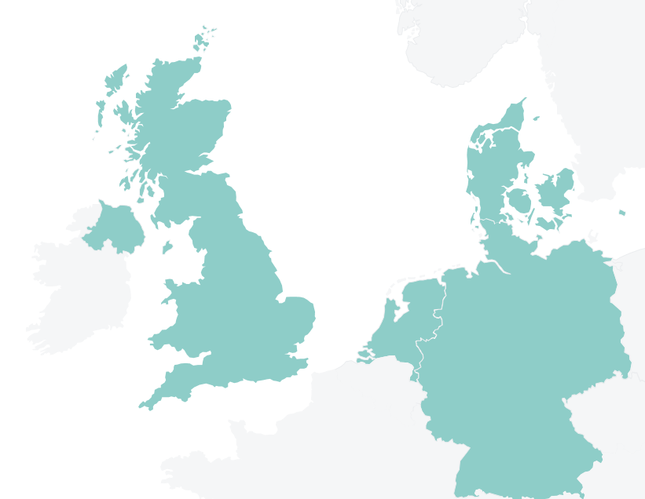

































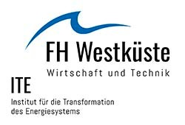




Ørsted – our hydrogen & P2X portfolio
Gigastack
FEED study, 100 MW
Link
Europa Seaways
23 MW
Link
Green Fuels for Denmark
1.3 GW
Link
SeaH2Land
1000 MW
Link
H2RES
2 MW
Link
Yara Sluiskil
100 MW
Link
Westküste 100 & HySCALE100
30 MW with upscaling to 700 – 2.100 MW
Link
Lingen Green Hydrogen
50 - 530 MW
Link

Slide 5
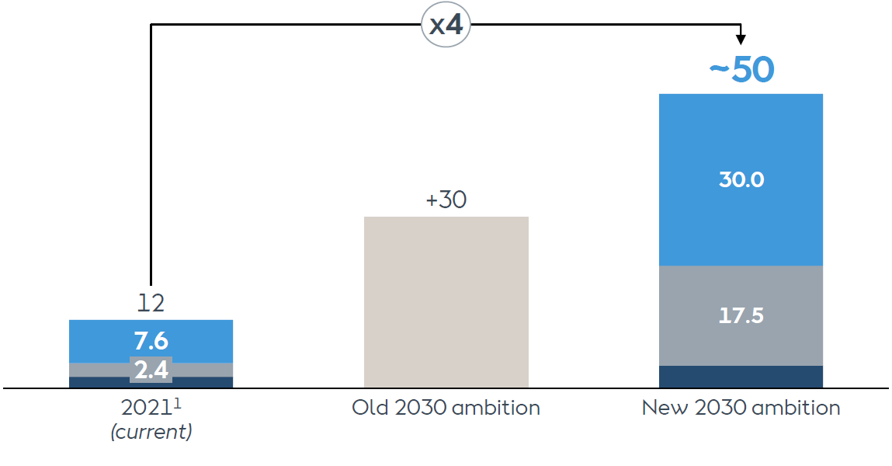
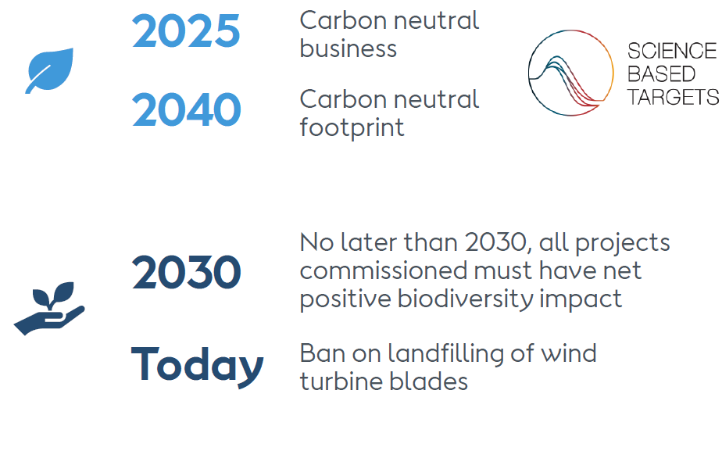
Ørsted ambitions towards 2030
Ambition to reach 50 GW by 2030
Leading sustainability ambition
 | Offshore wind
 | Onshore renewables
 | Other (incl. P2X)
^{1.} 12 GW includes 7.6 GW offshore wind, 2.4 GW onshore wind & solar PV and 2.1 GW biomass

Slide 6
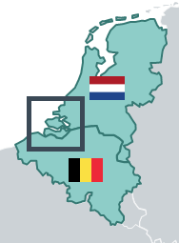


Connecting supply and demand: value chain integration is the way forward
SeaH2Land connects large scale offshore wind to direct & indirect electrification in North Sea Port region
SeaH2land at the North Sea Port
Indicative illustration
  New offshore
  wind farms
  (~ 2 GW)
Develop an offshore wind farm (2GW) on one of the
sites designated for additional offshore wind with cable permitting tracks to Zeeland.
Direct electrification of the industry present in the North Sea Port to support its decarbonization agenda e.g. electric cracking, EAF etc.
Connect to large-scale electrolysis in the largest gray hydrogen cluster in the Netherlands e.g. green ammonia, green fuels, CCU etc.
Unlock infrastructure in dialogue with TSOs
  380kV: extension to Zeeuws-Vlaanderen and potentially interconnection to Gent
  Hydrogen pipelines: regional backbone connecting to national backbones NL and BE
ROTTERDAM
  Hydrogen
  Backbone
Offshore
power
cable
Onshore
Power grid
(380 kV)
BORSSELE
  Electrolyser
  (~1 GW)
  380kV
  H2
  Electrification
ANTWERP
GHENT

Slide 7
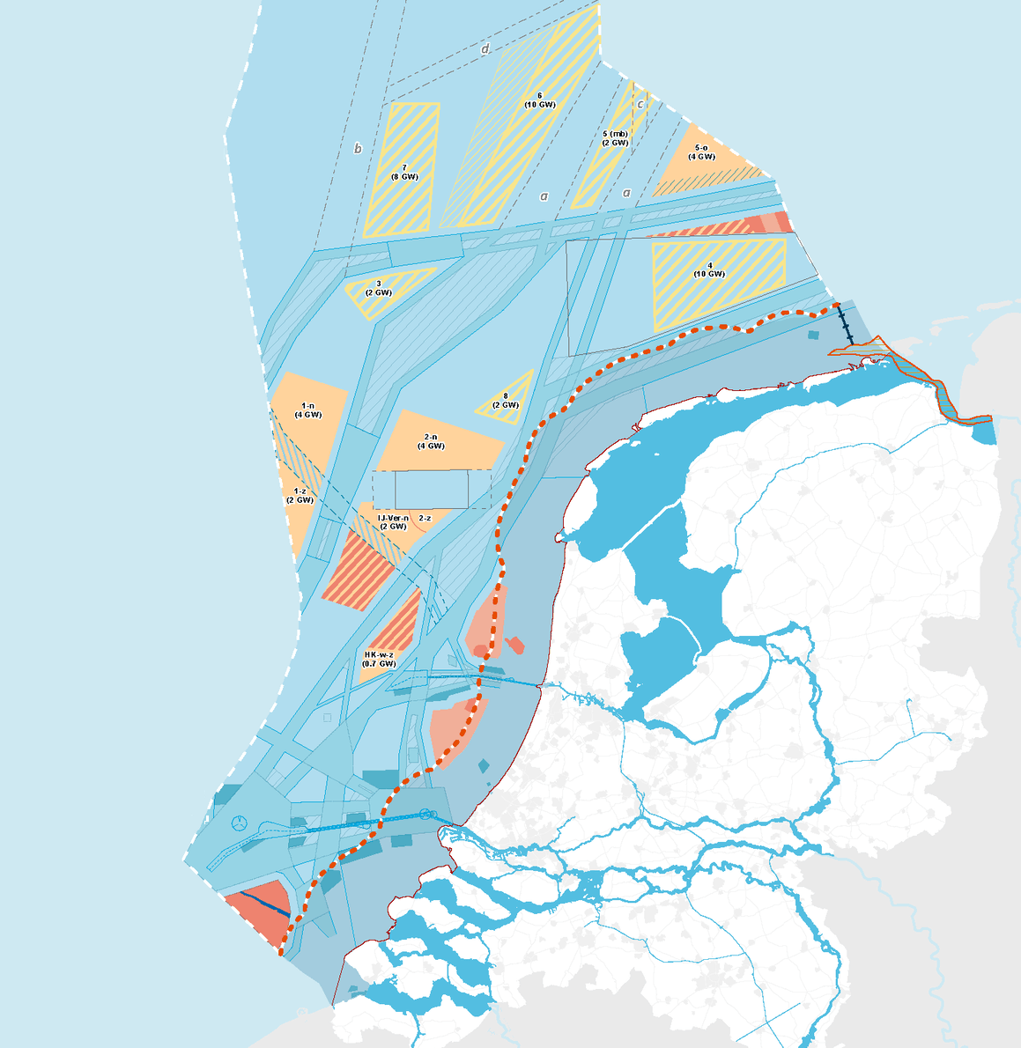
10.7 GW extra offshore wind needs to be realised on top of the current roadmap for 2030
 | Offshore wind farm | Capacity | Award | Realisation
Roadmap 2023 | Borssele I and II | 752 MW | 2016 | 2020
 | Borssele III and IV | 732 MW | 2016 | 2021
 | Holland Coast South I and II | 760 MW | 2017/18 | 2022
 | Holland Coast South III and IV | 760 MW | 2018/19 | 2022
 | Holland Coast North | 759 MW | 2019/20 | 2023
Roadmap 2030 | Holland Coast West VII | ~1,4 GW | 2022 | 2024-2026
 | North of the Wadden | ~700 MW | ??? | 2031
 | IJmuiden Ver I and II (Alpha) | 2 GW | 2023 | 2028
 | IJmuiden Ver III and IV (Beta) | 2 GW | 2024 | 2029
Additional pre-2030 volumes | Site within area 1 or 2 – cable to Borssele | 2 GW | ??? | 2028
 | IJmuiden Ver North (Gamma) | 2 GW | ??? | 2029
 | Site within area 1 or 2 – cable to Maasvlakte | 2 GW | ??? | 2030
 | Site within area 5 – cable to Eemshaven | 2 GW | ??? | 2031
 | Site within area 5 – cable to Eemshaven | 2 GW | ??? | 2031
 | Holland Coast West South | ~700 MW | ??? | >2031
7

Slide 8
What can and should a new allocation method address?
A system approach in which demand and supply are connected is key
Targets
Onshore
Grid
Ensure the offshore wind output is integrated in the energy system and not curtailed
Ensure the offshore wind farm is realised on time
Business
Case
Green
Industry
Ensure the project creates CO2 reductions in the industrial clusters at lowest cost
Ensure sufficient demand is created and linked to the project

Slide 9


Two fundamental things need to change to put in place a mechanism for allocation that serves realisation and integration
Timing of tenders Goal of tenders
Targets
Onshore
Grid
Business
Case
Green
Industry

Slide 10


Let’s create a world
that runs entirely on
green energy
Notes:
Climate change is a reality, and it’s rapidly changing the conditions of life on Earth.
To protect our shared home, we need to become better at powering it with green energy.

