Slide 1
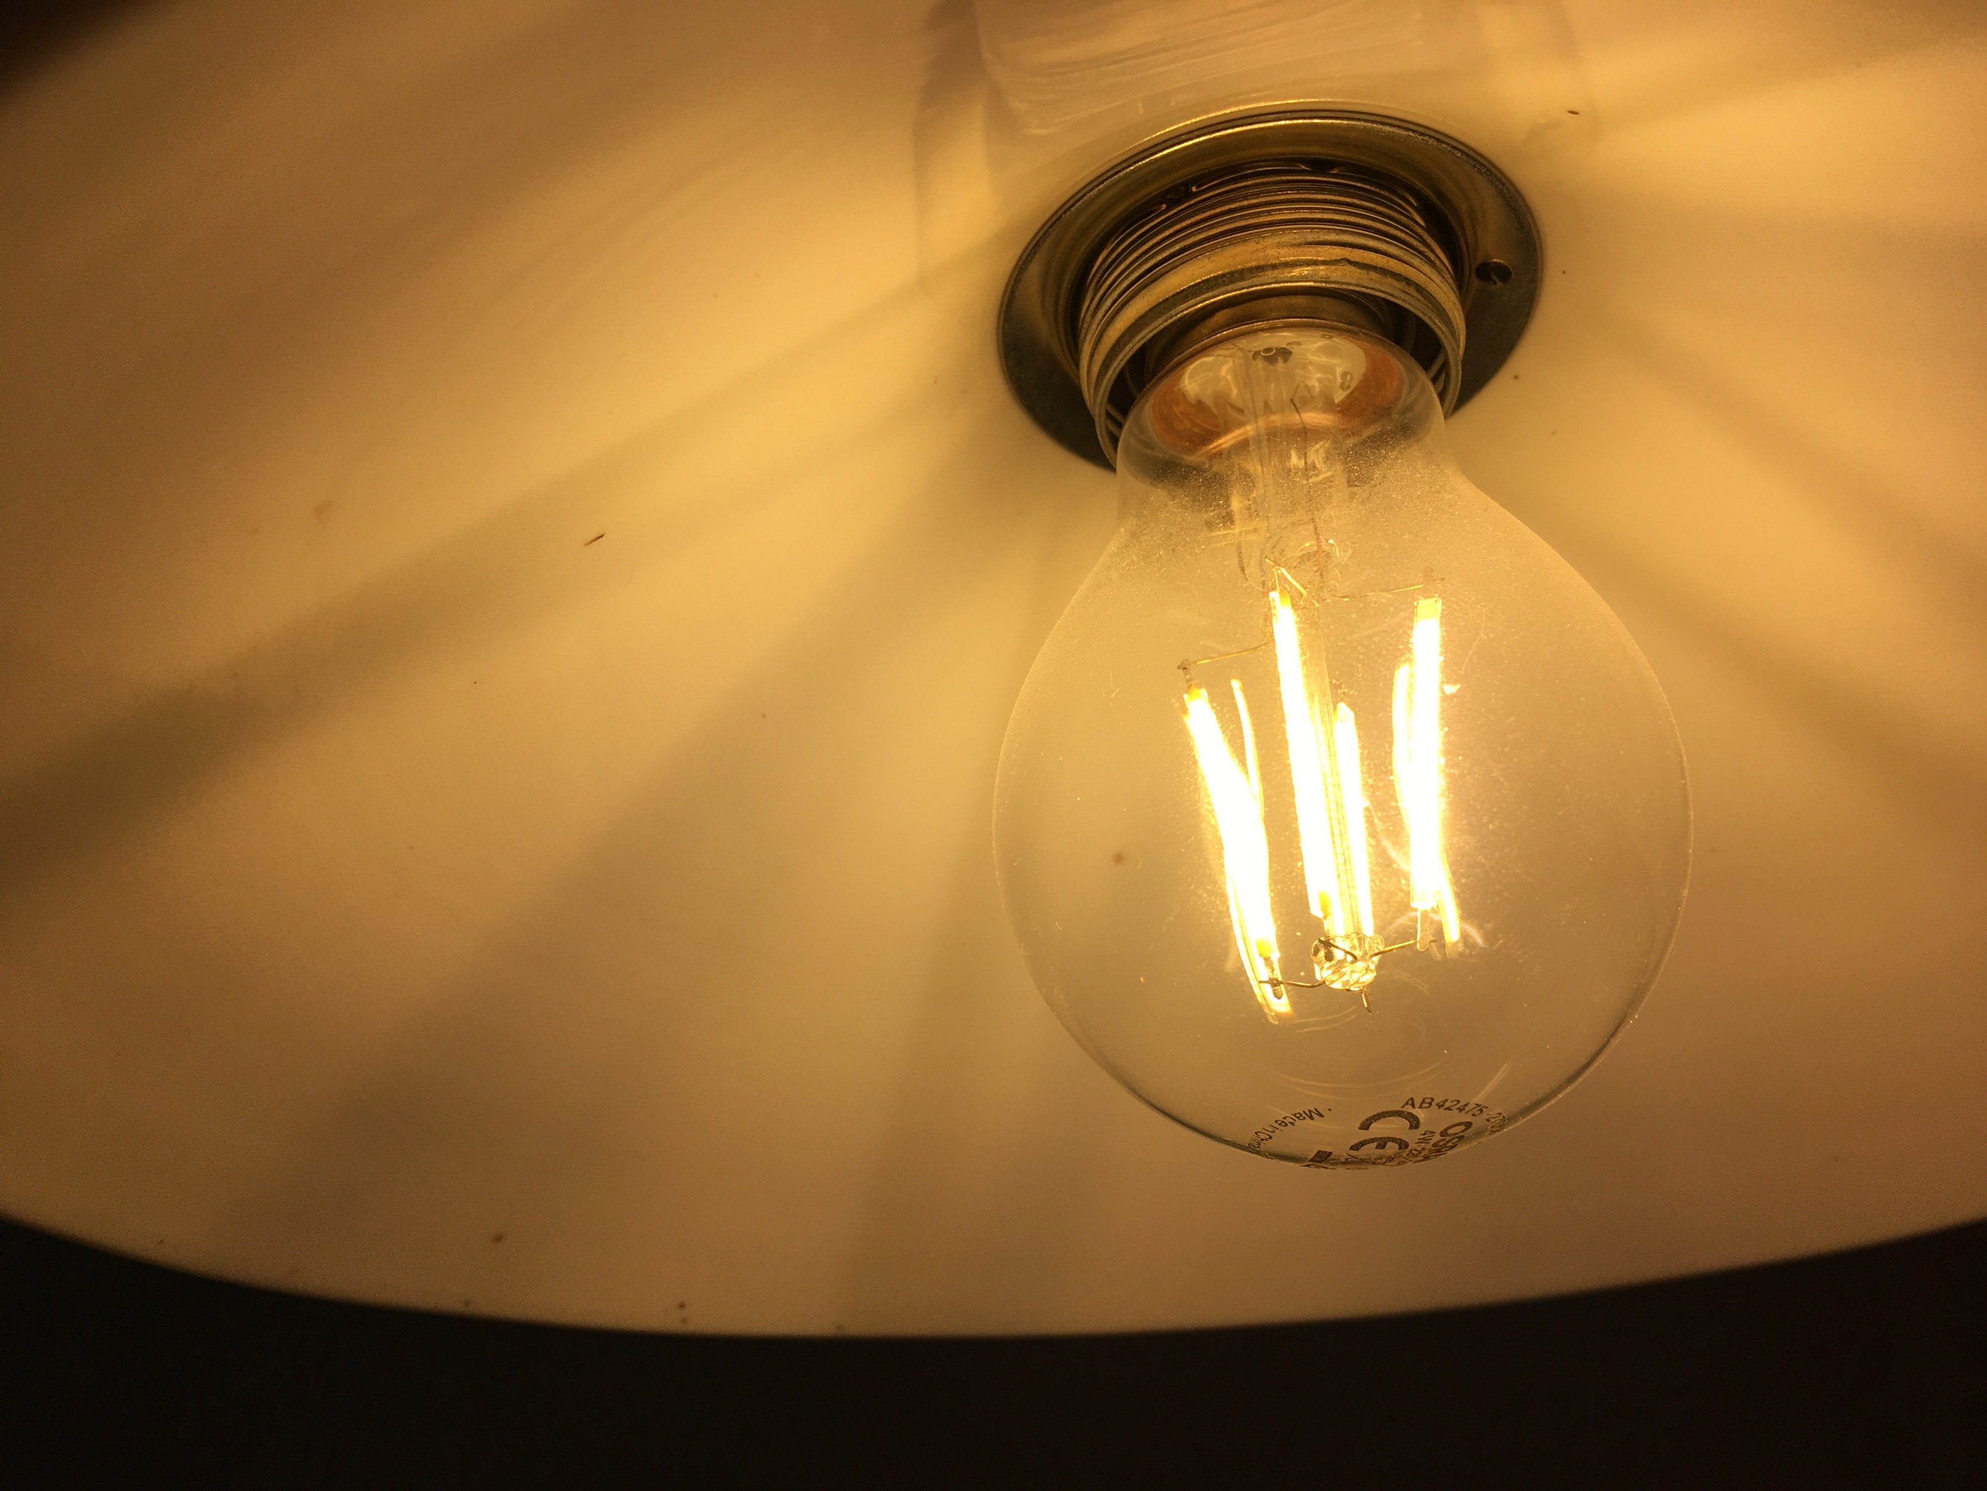
Energy Efficiency Watch 4 - Survey results and the impact of narratives on effective policy implementation s Daniel Becker, Guidehouse 20 October 2021
This project has received funding from the European Union’s Horizon 2020 research and innovation programme under grant agreement No 847153.
Notes:
Webinar preparation
Store the Power Point Presentation that will be presented locally on your computer
Check the camera and light conditions as well as the audio quality before the webinar.
Familiarize with the webinar platform, especially with the functions for screen sharing and screen recording.
Screen sharing: 1. Start presentation mode in Power Point, 2. Share screen in Zoom selecting ‘Power Point Slide Show’.
Please advise your family members before the workshop to avoid using the internet connection during the webinar.
Turn of apps on your computer that utilize the internet connection.
Print out a participant list with names and organizations for taking notes during the welcome session. The list can be useful for namely referring to participants during the discussion with additional background information.
Moderator starts the webinar by sharing the application view of Power Point.
Contingency planning for connection issues
Dealing with light connection issues: Turn of the video feature for the moderator and turn of any other apps that might use the internet connection. Ask for a brief break and ask your family to stop using the internet connection if possible.
Dealing with strong connection issues: Announces that the session has to be canceled due to the connection issues and that there will be further notice via email. Also leave a message in the chat box.

Slide 2
Background: Energy Efficiency Watch 1-4 From policy analysis to the role of narratives
2007
Today
Hardly any proven energy efficiency policies around when NEEAP process started
Initially, predominance of info campaigns
Many approaches still rather theoretical
Often doubted whether broad energy efficiency policies could address complex savings potentials
Impressive toolbox of energy efficiency policy instruments
Many of them are really good practice!
Decentral EU approach provides great variety
➔ Yes we can: EU-27 has succeeded in developing good energy efficiency policies!
Notes:
Notes for presentation
Comparing the starting point in 2007 with the current situation allows for the conclusion that the process of defining and shaping policy instruments has been faster and more successful than expected
However, the comparison also shows that the implementation of these policy instruments is very unevenly distributed among EU MS and to slow for target achievement on EU level
Comparing the progress of EU MS on an overall level, many ups-and-downs in the level of ambition of energy policies were observed
Background
In 2007, when the National Energy Efficiency Action Plan (NEEAP) process started, hardly any proven energy efficiency (EE) policy instruments were in the implementation stage. Many approaches were still rather theoretical, and it was often doubted whether broad EE policies could address the complex savings potentials across the various sectors (prominent example: it was generally assumed that supplier obligations could only deliver for highly standardized potentials in the building sector, but practice showed that they also successfully tapped large and complex industrial potentials). A decade later, after the third set of NEEAPs had been prepared, an impressive tool box of EE policies had evolved. Many of the instruments can be characterized as ‘good practice’. It has been proven that through the NEEAPs member states succeeded in developing well designed EE policies. The decentral approach across the EU MS has positively contributed to the variety of approaches and provides a rich source for mutual learning. Nevertheless, even a well-designed instrument is bound to fail or remain far behind its potential when implementation is lagging behind or done in a half-hearted manner (stop-and-go, frequent changes, intransparency, high transaction cost etc.).

Slide 3
EU27: Key input factors for narrative development
Topic |  | Importance in the public debate (ranking) |  | Topics linked to energy efficiency (ranking) | Positively discussed | Negatively discussed |  | Actor group | Influence on politics (ranking) | Supportive of energy transition | Opinion not known | Opposed to energy transition
Jobs |  | 1 |  | 6 | 72 % | 28 % |  | Associations of large industry | 1 | 47 % | 13 % | 40 %
Industrial competitiveness |  | 2 |  | 2 | 63 % | 37 % |  | Trade Unions | 2 | 37 % | 40 % | 23 %
Modernisation / investments |  | 3 |  | 1 | 44 % | 56 % |  | Chambers of Commerce | 3 | 52 % | 28 % | 20 %
Housing / living costs |  | 4 |  | 3 |  |  |  | Tabloid press | 4
Air quality |  | 5 |  | 4 |  |  |  | Farmers organisations | 5
Independence from other countries |  | 6 |  | 5 |  |  |  | NGOs | 6
Rural development |  | 7 |  | 7 |  |  |  | Churches | 7

Slide 4
Narrative cases from business stakeholder workshops
Wanting to be a front runner
EE as integral optimization of production cycle
Only talk about a real business case
Transparent foundations for EE achievements
Understand your clients: working with the image of technologies
Just transition – (where) is compensation really needed?
Communication is key – the role of stakeholder dialogues
Research and innovation
The right pace for workforce qualification
Who is price sensitive and how to discuss cost distribution

Slide 5
Wanting to be a front runner
Starting point / past narrative: | Some countries (e.g. DK) have achieved broad societal consensus: ‚It is good for us to be a front runner‘ – this facilitates innovative thinking / active and smooth transformation
Changing narrative: | In many European societies, transformation is connotated primarily as an uncertainty or even a threat But even in ‘change sceptic’ contexts there is regional or sectoral experience / ambition to become pioneer in certain areas Often strongly linked with image / overcoming old & unwanted perceptions
Practical and policy implications: | Identify such potential and develop convincing front runner narratives connotate transformation as beneficial by showing pioneer advantages

Slide 6
EE - integral optimization of production cycle
Starting point / past narrative: | Energy efficiency = linear relation between energy input and economic output (in macro-economic terms as well as on business level). Narrow view on the economics of EE → reduces EE measures to issues like “payback period” → results in low priority for EE measures in many businesses (where energy prices are not sufficiently relevant)
Changing narrative: | EE is in some contexts thought of and communicated in a more integrated manner → optimization not only of the energetic performance but of the overall production process via EE measures → positive implications on quality of output, cost of production and overall competitiveness of business (not just with a view to energy costs).
Practical and policy implications: | Energy audits require a comprehensive understanding of the respective production cycle (thus requirements for high-quality EAs may be more clearly defined) Companies need to discuss EE not as a single matter but as a means to modernize the production process and improve the product / offering → at higher management level

Slide 7
THANK YOU
WWW.ENERGY-EFFICIENCY-WATCH.ORG
Daniel Becker & the Guidehouse Team
Daniel.Becker@guidehouse.com

