Slide 1
How to speed up the Green Recovery and reach 100% Renewable Energy in Finland
EUFORES Workshop “The National Energy and Climate Plans & the EU Recovery Plan: The Finnish Green Vision”
Tapio Tuomi, Executive Director, Finnish Clean Energy Association

Slide 2
Finland has an ambitious goal to became ”Carbon neutral in 2035” - We’ve done a lot, but even more is required

Slide 3
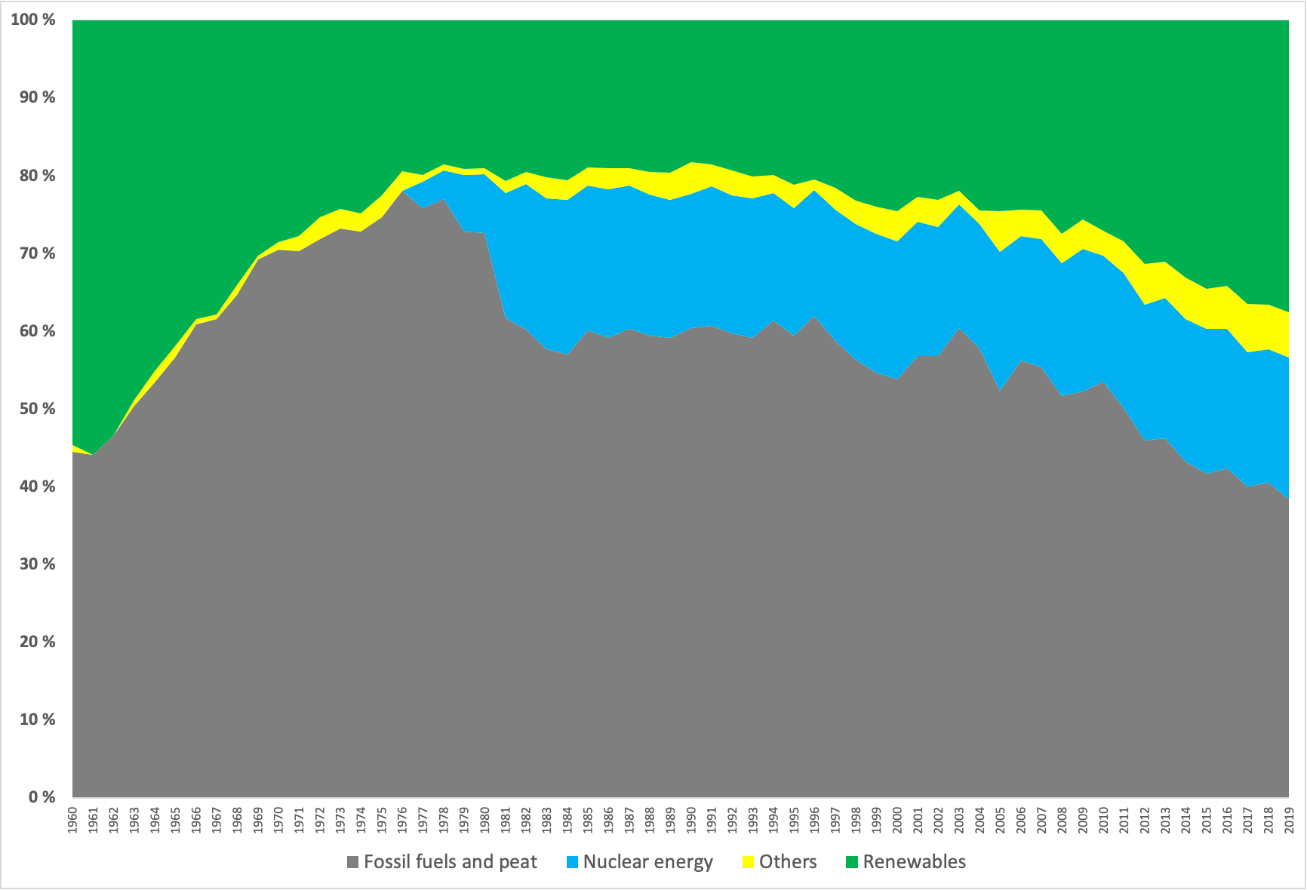
Our energy mix is improving. In 2019 renewables were equal to fossil fuels & peat
Source: Statistics Finland

Slide 4
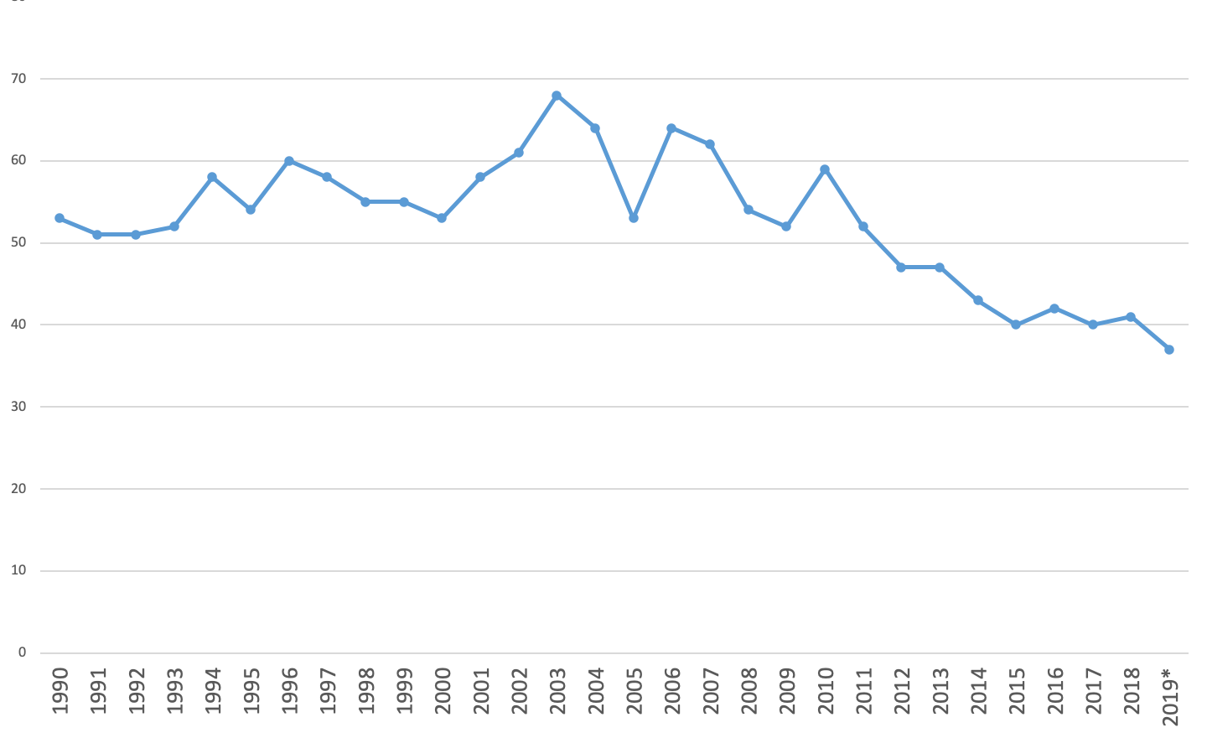
Greenhouse gas emissions from energy consumption have declined by 30% since 1990
Source Statistics Finland

Slide 5
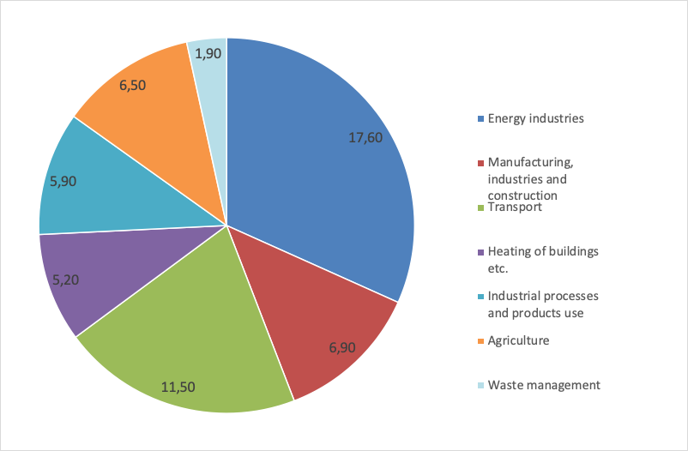
Greenhouse gas emissions by sector (million tonnes CO2 eq. 2017)
Source Statistics Finland

Slide 6
The two very important sectors are: transportation and heating. To reduce emissions in these sectors require special attention. And there’s a lot going on..

Slide 7
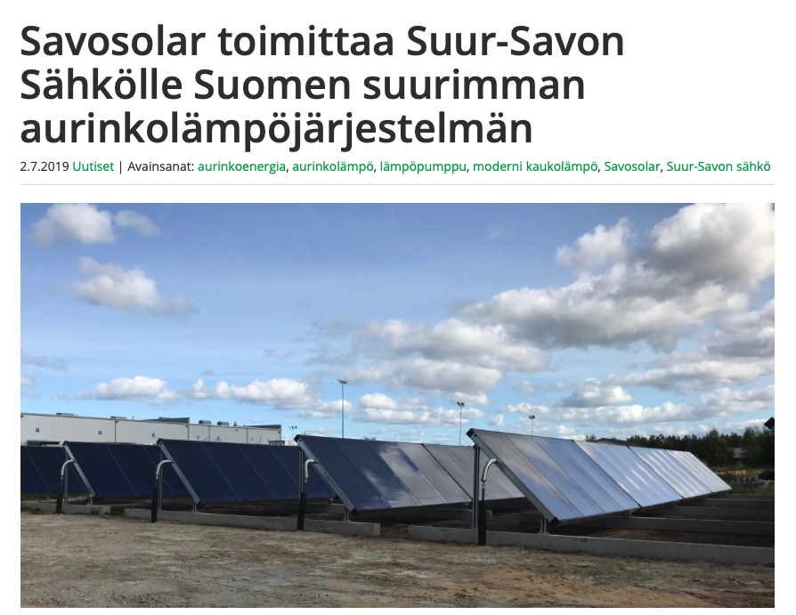
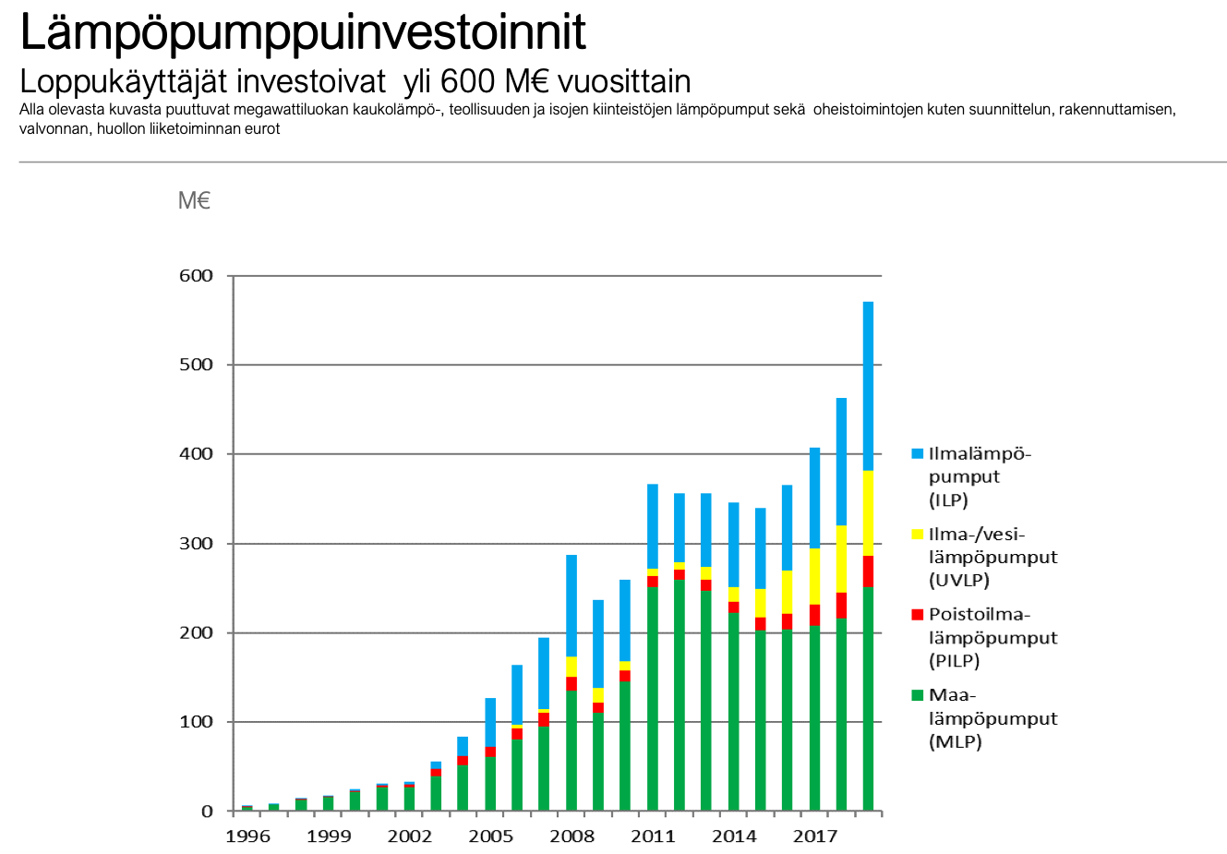
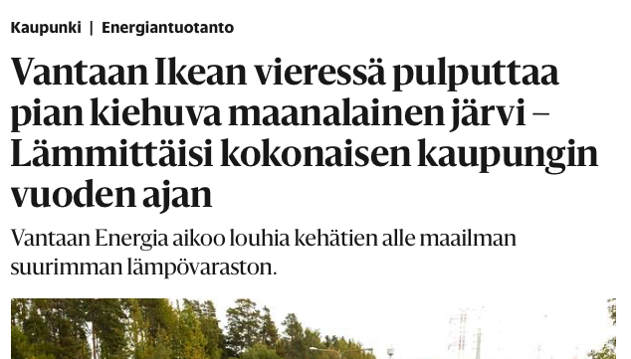
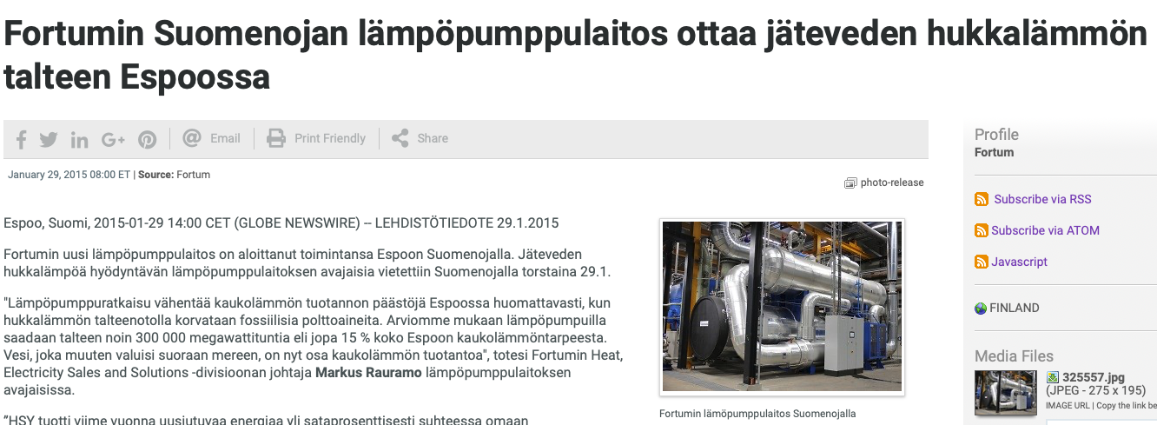
All size (residential to utility) heat pumps, solar thermal and seasonal heat storage are the solutions for clean heating and cooling
Solar thermal as part of district heating
Residential heat pumps 10 TWh/a
90 GWh seasonal heat storage
Heat from sewage
Waste heat from data centers

Slide 8
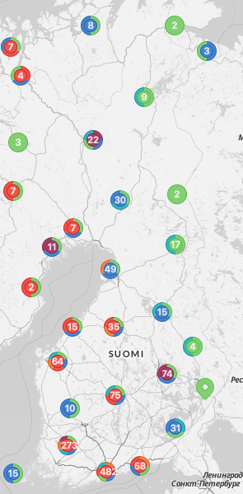
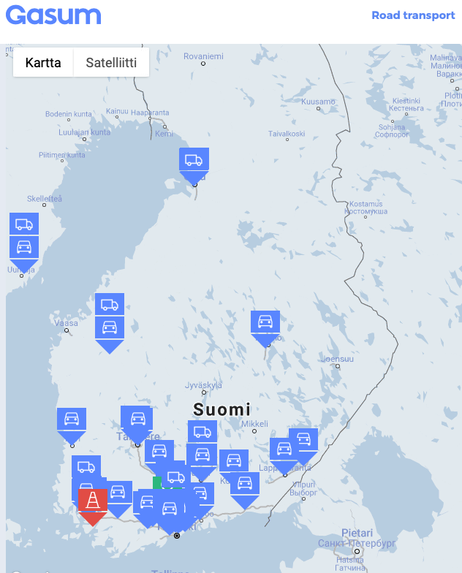
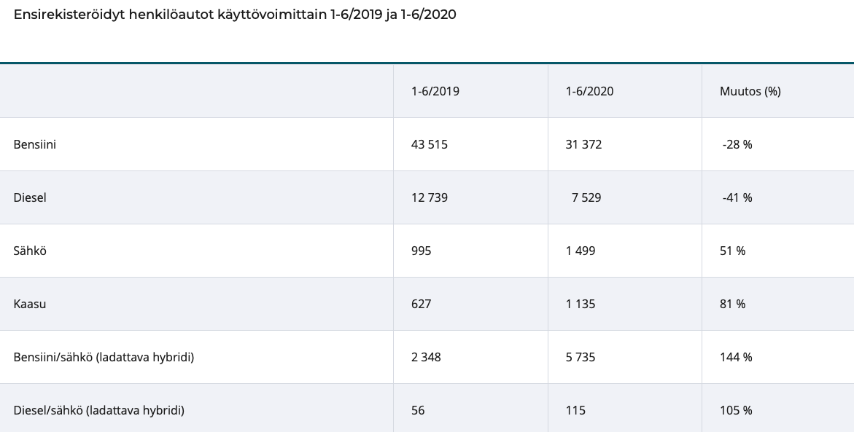
In transport more public transport, electric vehicles and biogas for heavy transport
State aid for building more
public EV charging stations
wider biogas filling station network (especially for heavy transport)
Increasing popularity of PHEV’s, EV’s and biogas car. And decreasing popularity of petrol and diesel cars.

Slide 9
To reach the carbon neutral target by 2035 we need to focus all of the energy related investments to green solutions

Slide 10
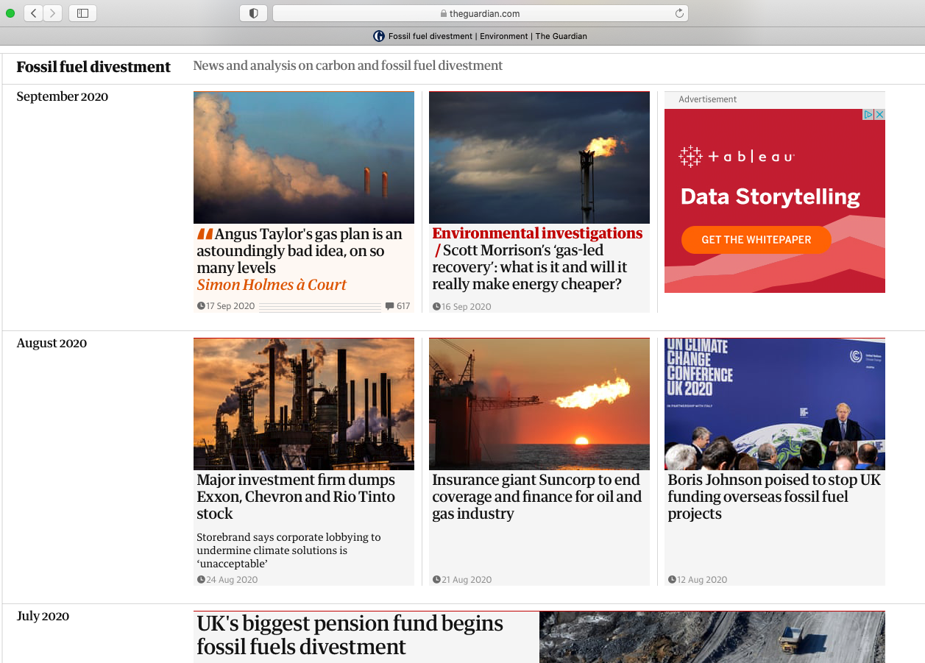
A lot of money searching for a good, green project. Investors have to learn find also smaller projects - in addition to traditional sizes (big) projects

Slide 11
Public funding and state aid must be used ONLY for green investments
EU Green deal, Next Generation EU and national support schemes are required - specially at this very uncertain situation.
The newly published Finnish national public procurement strategy implementation will be of help. It contains guidance to support both innovations and carbon neutrality

Slide 12
And to end on a high note: The current legislation and regulation encourage and enable distributed energy production - and improvements of energy effiency

