Slide 1
Engaging with customers to develop fair district heating systems, the Finnish example
Jussi Laitinen
Chairman, Finnish Energy
CEO, Tampereen Sähkölaitos/ Tampere power utility

Slide 2
Finnish approach to develop a customer strategy
Energy Company
Customer
Conclusion:
Customer didn’t have a clear vision about the energy future
(technology is developing rapidly)
-> We will build the energy future TOGETHER
What happens inside the energy company or in it’s operating environment?
Conservative = OLD approach
What happens in customers operating environment?
What are the expectations?
Innovative = NEW approach
Customer orianted Strategy?

Slide 3
Example:
Smart district heating
Savings
Indoor comfort
Real-time information

Slide 4
Working principle
10 %
smaller district heating costs without impacting the indoor air quality
BEFORE
AFTER
END RESULTS
No knowledge of indoor conditions
Heating is controlled in relation with outdoor temperature
Temperature sensors installed in apartments (IOT)
Heating is controlled in relation with the measured indoor temperature while utilizing other data sources, such as weather forecasts to be more energy efficient
Heating is done purposely and on demand
The entire system is continuously monitored to ensure proper function and to spot other possible issues in the real estate

Slide 5
Smart district heating
Demand side management (DSM) of the district heating system
Heating is reduced when hot tap water is peaking
Peak cut up to 20 % without reduction in indoor quality
(We need to produce LESS peak energy - > more profit to energy company)
Based on average indoor temperature and weather forecast (be clever and foresee tomorrow)
Traditionally heating is adjusted based on outdoor temperature
Cost savings up to 10 %

Slide 6
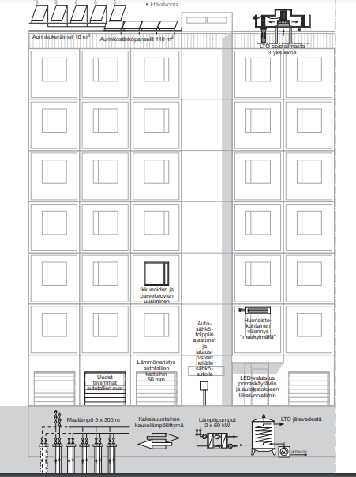
Case Tampere - in use
Old building equipped
with modern technology
Solar Panels
Exhaust air heat pumps
Geothermal heating
Waste water heat recovery
Two-way district heating
IOT-based control and reporting system
-> all commercial technology!
Energy savings 50 %!

Slide 7
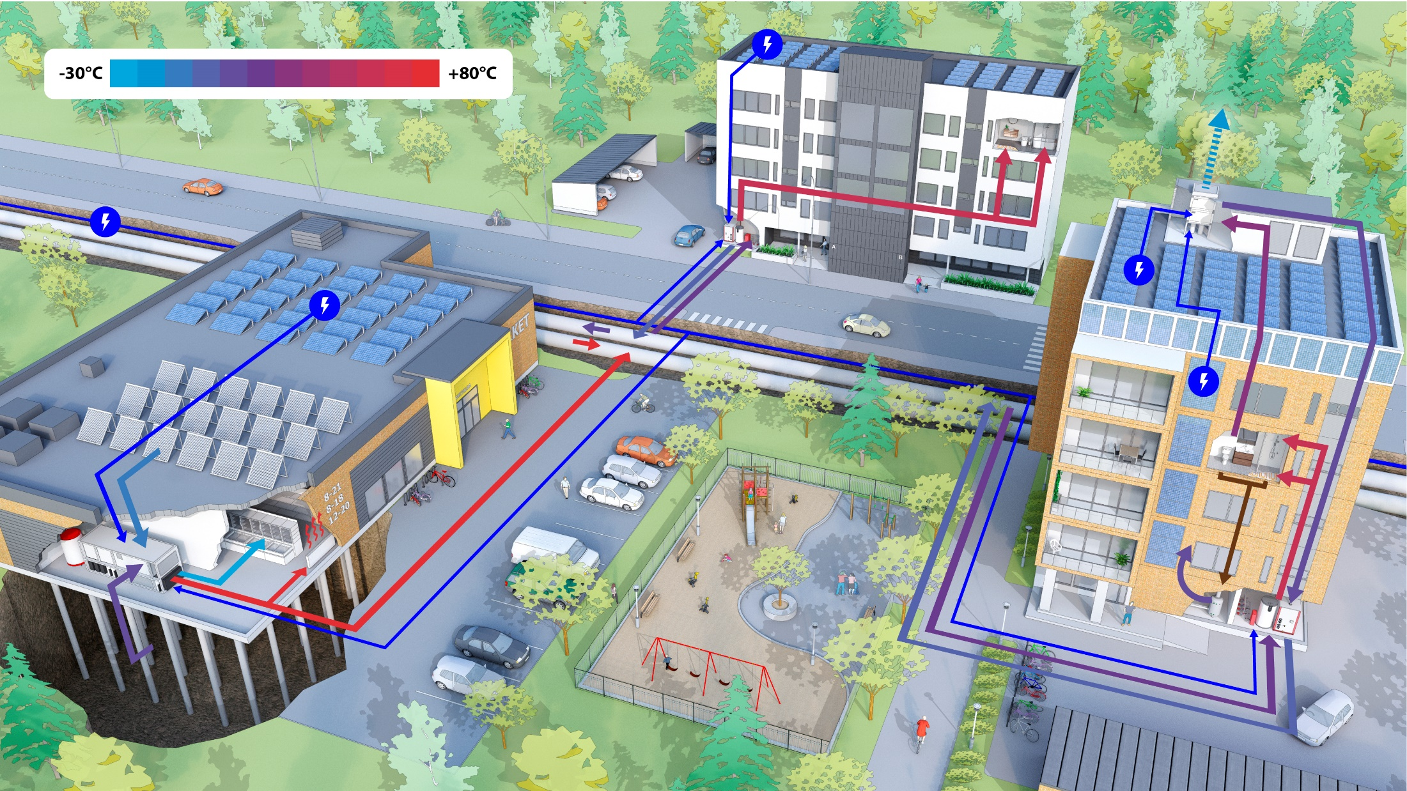
Case Oulu – under construction
New and old buildings equipped
with modern technology
All buildings are connected to each other
via district heating systems (high and low temperature)
Electricity from solar panels
Heat pump cools down the outcoming air from ventilation and supplies heat for space heating and hot tap water
Electricity is supplied from the electricity networks, when the own production is not enough. System is flexible, which makes it possible to have large shares of wind and solar power.
Heating is supplied from the district heating network, when the own production is not enough.
Heat pump cools down the return water of district heating and supplies heat for space heating and hot tap water
District heating network enables transferring heat from one place to another
Heat from solar collectors, with heat pump also in winter
Heat is recovered from sewage water to preheat hot tap water
In summer excess heat to boreholes, in winter heat extraction from those
Heat from grocery store refrigeration to district heating network
First Positive Energy District (PED) application in Finland?
Source: Oulun Energia Oy

Slide 8
Case Espoo –under construction
Old buildings equipped
with modern technology
R&D collaboration with
Aalto university.
We expect good results!
Source: Fortum

Slide 9
Summary
It is time finally to focus on energy consumption – not only energy production (e.g. ETS, taxes, and unpredictable politics)!
Develope solutions with customer! Customers can not follow the fastly developing technology. Towether we can.
Huge energy savings can be achieved (10..50 %)
Althought the cost is the problem today – maybe not tomorrow
This can be done to a old building which represents the majority of the buildings in Finland
This can be done to new city districts
Can this be done to a whole city step by step?
District heating lives forever – only the source of energy is changing while the tehchology is deloping.
New technology and district heating systems together can solve the climate issue.

