Slide 1

Workshop
Short and Long-term Outlook for Renewable Energies in France
Lessons Learnt
from the Current Crisis
for the Evolution
of the French Energy Mix
Yves MARIGNAC
Spokesperson,
Head of prospective analysis
Association négaWatt
25/06/2020, EUFORES
Visioconference
Soutenu par la Fondation Charles Léopold Mayer pour le progrès
de l’Homme

Slide 2
The négaWatt Approach
A systemic approach to address a systemic issue
Notes:
Si possible, version sans motifs vidéo de la photo (ou une autre)

Slide 3
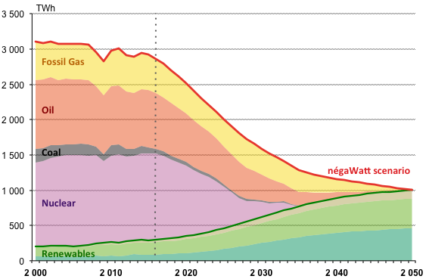
The négaWatt Scenario 2017-2050
France: primary energy supply
Increased
efficiency
& sufficiency
100%
renewable
energy supply
Zero carbon
Reaching
carbon neutrality
Environmental
benefits
Materials, pollution…
Socio-economic benefits
Jobs, social justice…
Notes:
3

Slide 4
Global Sustainability
Score over 17 economic, social & environmental
UN Sustainable Development Goals (SDG)
(minimum / mean / maximum)
Options for reducing GHG emissions
Source: négaWatt, based on IPCC (2018), Special Report 1.5°C

Slide 5

Resilience
POSSIBLE
SHOCKS
CHAINS OF
CONSEQUENCES
MULTIPLE
IMPACTS
Reducing occurrence
and size of shocks
by addressing root causes
Reducing vulnerability
of the economic / social
system to residual shocks
Reducing sensitivity
to residual economic, social
and environmental effects
Sufficiency > Efficiency > Renewables
A KEY DRIVER / ENABLER OF REDUCED RISKS
AND INCREASED RESILIENCE

Slide 6
French Plans for the Electric System (1)
Massive life extension of existing reactors
  Short-term economic reasoning about least investment costs
  Leads to a call for preparing a plan of new build (EPR reactors)…
Projected life extension of reactors through the Pluriannual Energy Plan
Notes:
Si possible, version sans motifs vidéo de la photo (ou une autre)

Slide 7
French Plans for the Electric System (2)
Massive increase of French electricity exports
  A mechanical result of the addition of prolonged nuclear and new renewables
  Turns to a condition for developing renewables…
Projected increase of electricity exports through the Pluriannual Energy Plan
Notes:
Si possible, version sans motifs vidéo de la photo (ou une autre)

