Slide 1
Smart Energy Transition in Latvia and around the globe
Dr.oec. Olga Bogdanova
AS “Augstsprieguma Tīkls”
Supervisory Board of Power Transmission System Operator

Slide 2
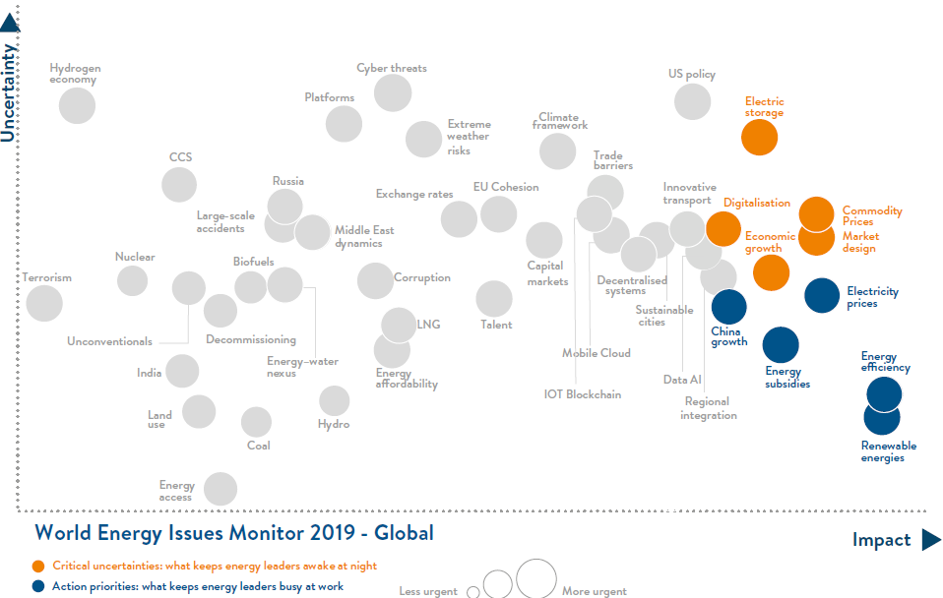
The global perspective of the Energy Transition
Source: World Energy Council

Slide 3
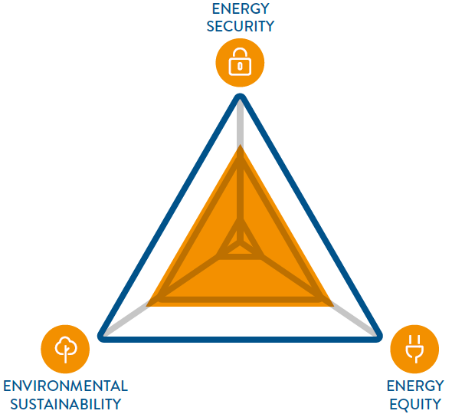
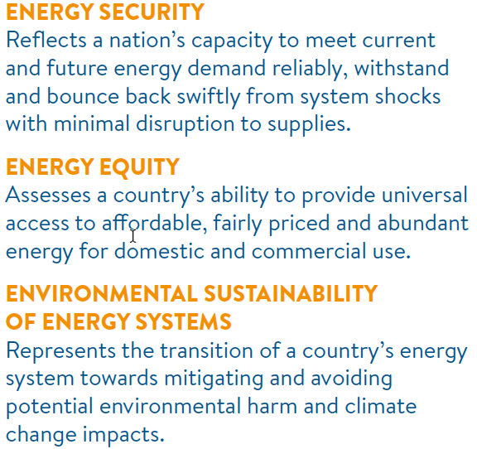
Global Energy Transition process
Managing a successful global energy transition – one that secures the benefits of reliable, affordable and sustainable energy for all – is challenging.
Source: World Energy Council

Slide 4
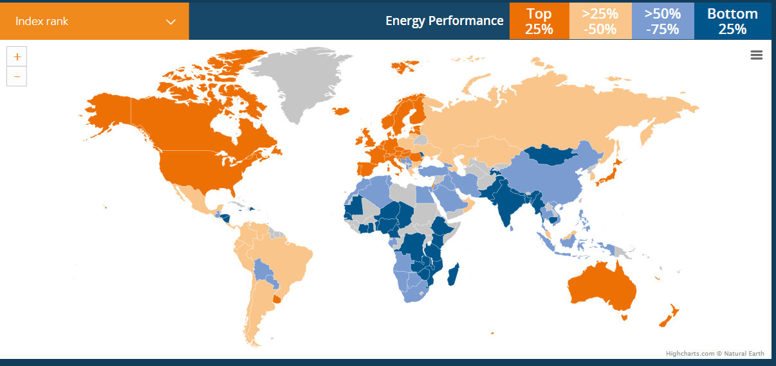
Trilemma index rank (total)

Slide 5
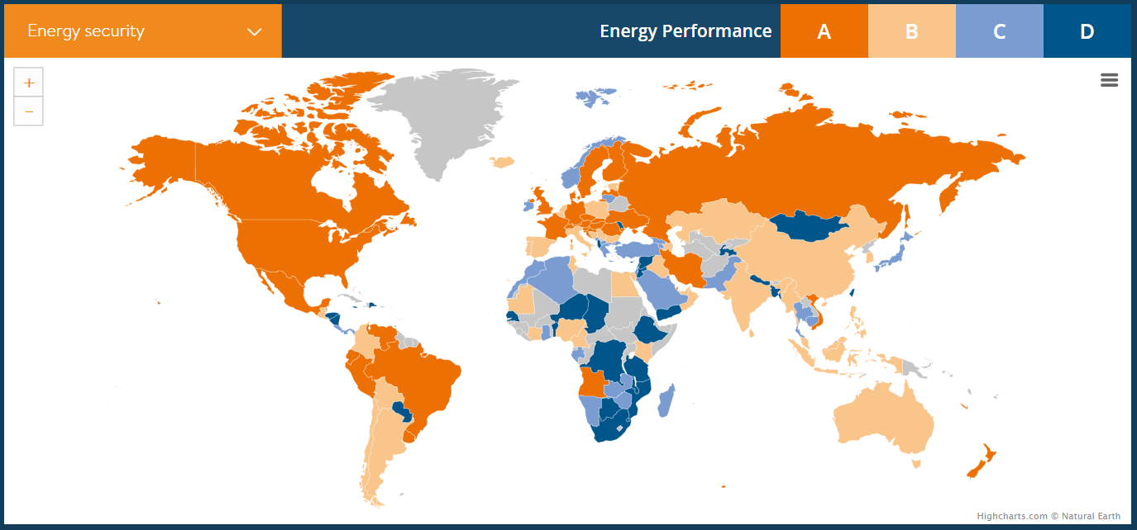
Trilemma index rank (energy security)

Slide 6
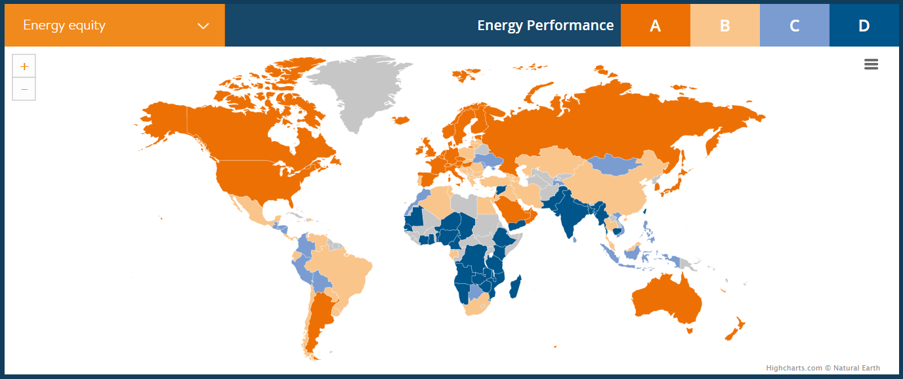
Trilemma index rank (energy equity)

Slide 7
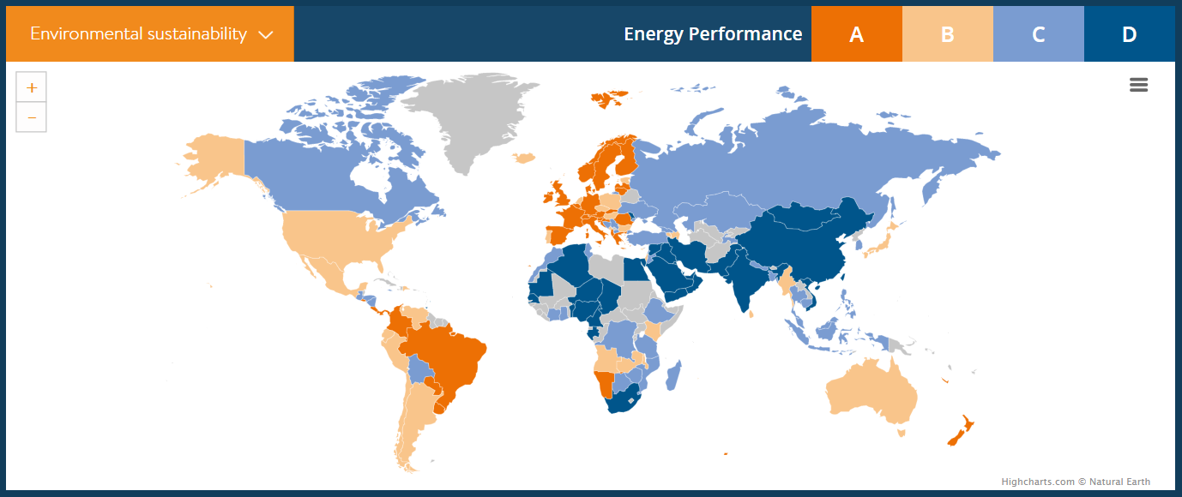
Trilemma index rank (energy sustainability)

Slide 8
The Baltics: going greener!
Wind
All generation, except wind

Slide 9
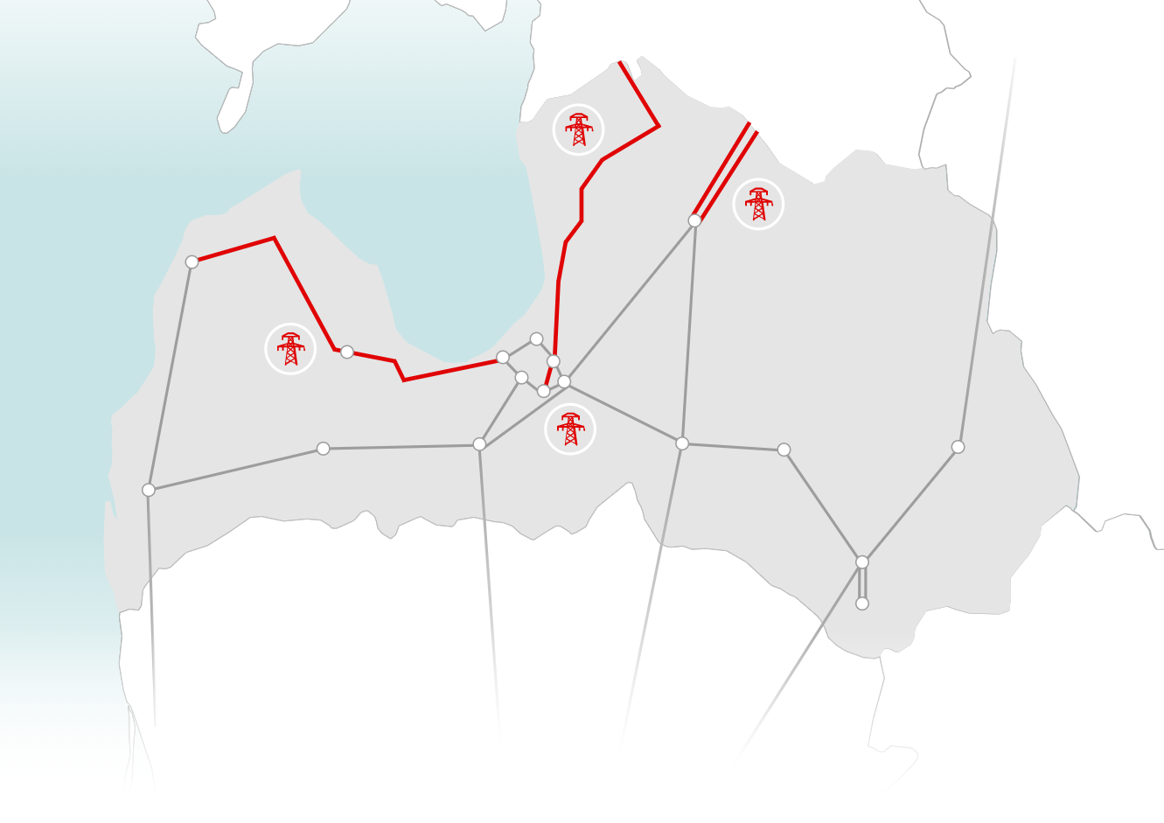
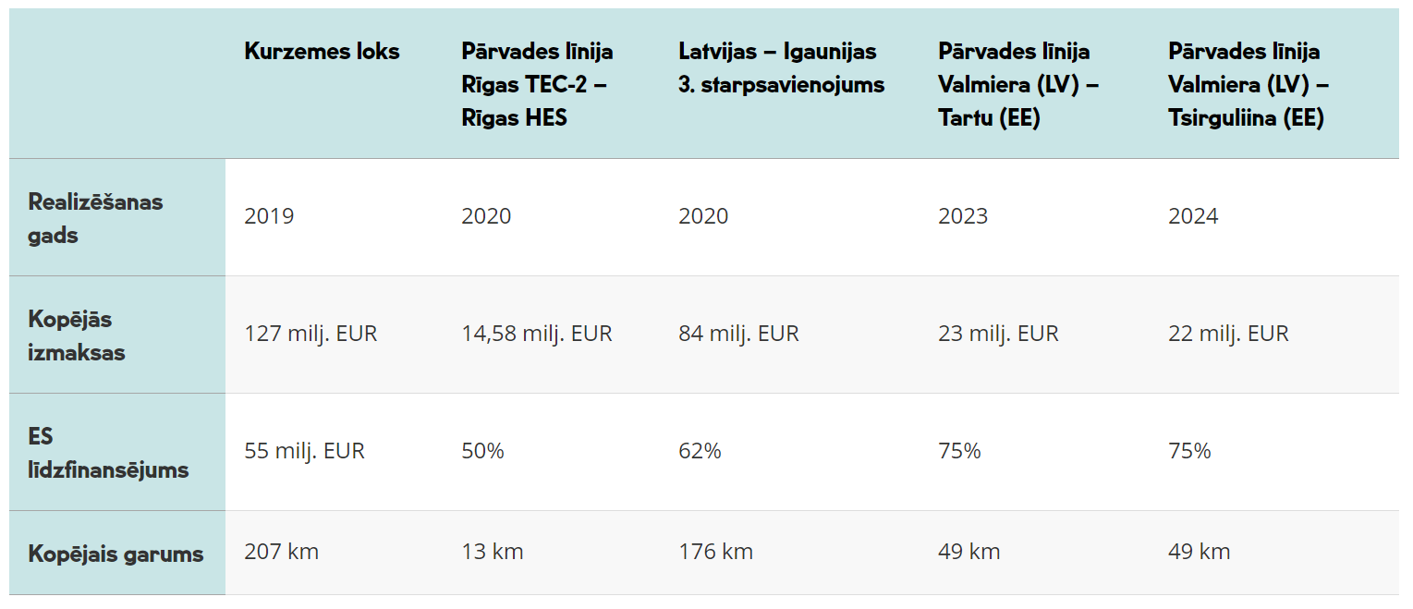
1. Network development
Year of realization
Total
costs
EU financing
Total length

Slide 10
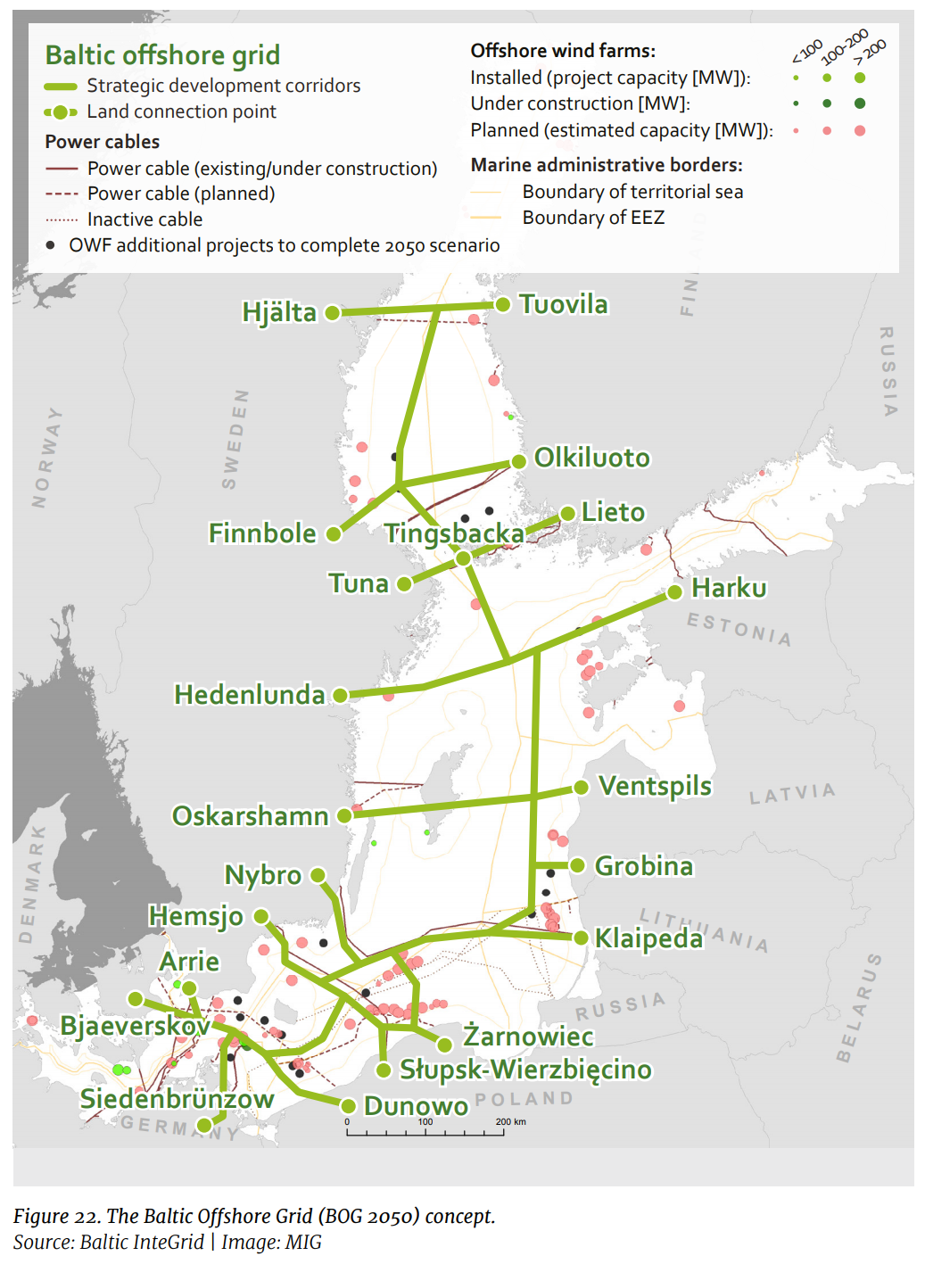
2. Ballancing
Wind energy generation in the Baltics
Wind energy generation, 2019 Oct.
Consumption, 2019 Oct.
Simulation – wind generation 4000 MW

Slide 11
Questions to face
New generation capacities;
Ballancing market development;
Network adjustment to the needs;
Depand response;
Energy prices!

Slide 12
Thank you!

