Slide 1

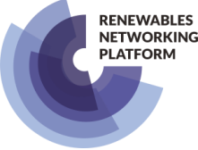

Capacity for Renewable Energies in the transmission System of Slovakia
Renewable Energies in Slovakia - Opportunities and Challenges ahead │ 15 October 2020│ Online Conference
Karol Kósa
Executive Director of the Electricity System Development
Slovenská elektrizačná prenosová sústava, a.s.

Slide 2
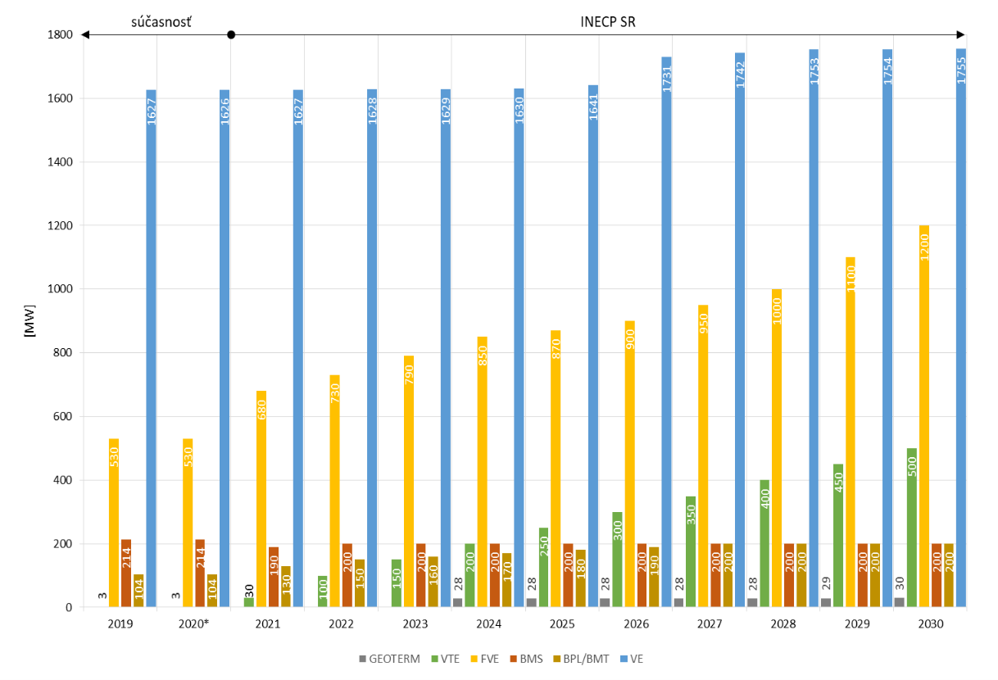
Future challenges
 | Year 2018 | NAP RES 2010 (Goal 2020) | NECP SR (Goal 2030)
podiel OZE (%) | 11,9 | 14,0 | 19,2
RES-T (%) | 6,9 | 10,0 | 14,0
RES-H&C (%) | 10,6 | 14,6 | 19,0
RES-E (%) | 21,5 | 24,0 | 27,3
Pnom FVE (now) (MW) | 530 | 300 | 1 200 (538)
Pnom VTE (now) (MW) | 3 | 350 | 500 (3)

Slide 3
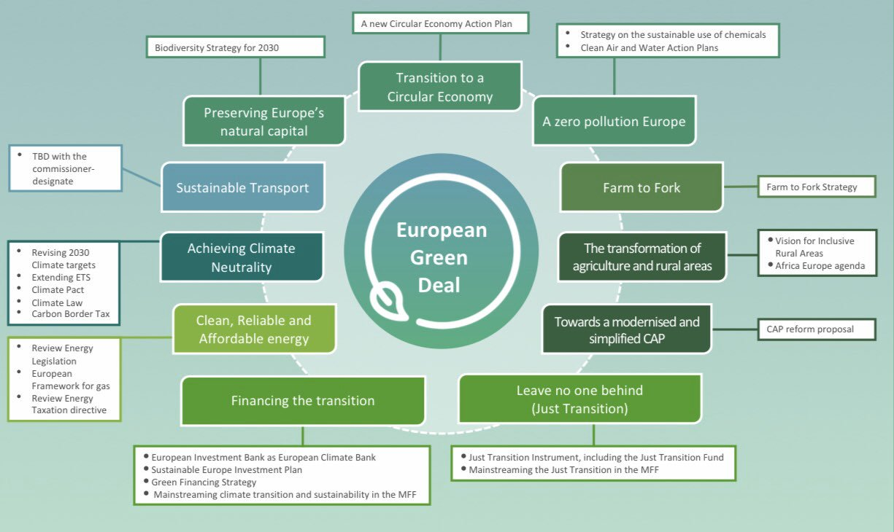
Future challenges
Carbon - Free Economy

Slide 4
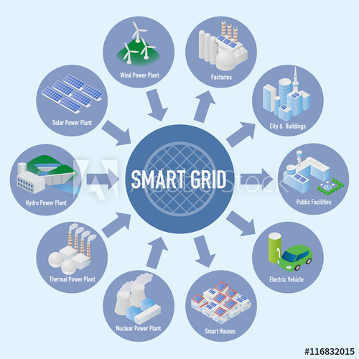

Basic presumption for electricity sector transition
Modern and smart grid is inevitable
Enough capacity in each time
Enough flexibility in each time
Affordable electricity in each time
How to reach that?

Slide 5
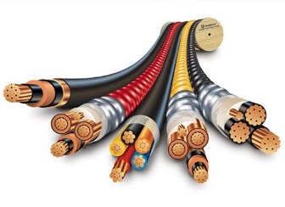

Future challenges in graphics
Grid operators
Grid users
Enough Grid Capacity
Sufficient System Flexibility
High RES
Integration
Affordable electricity
GOAL
Efficient Market
supported by:
Legislation
Reg. framework
HOW?
WHO?
DESIRE

Slide 6
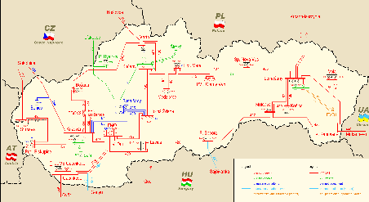
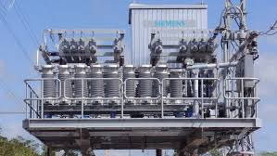
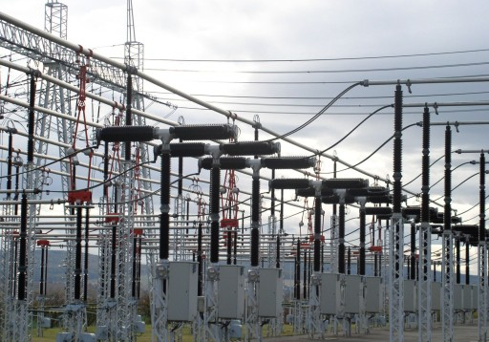

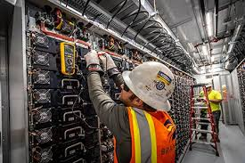
Actions – Invest to the grid modernization
Capacity increase, Interconnection target 2030
Smart control equipments
Asset replacement, Modernization
Grid digitalization
Sectors electrification
!

Slide 7



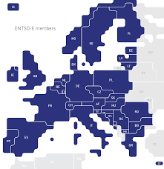
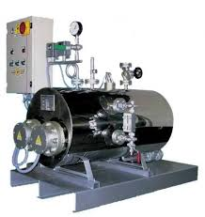
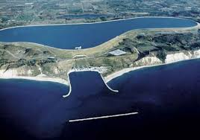
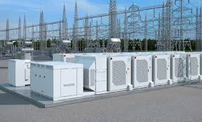
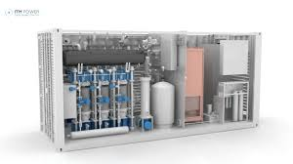


Action - Increase the system flexibility
Aggregation of grid users
Refurbishment of existing thermal power plant
Demand Side Respond
Using of ancillary services from wind and photovoltaic power plant
Using of missing ancillary services from abroad
Implementation of P2G, P2X technology
Implementation of storages (bateries, el. boiler, hydro pumped storage)
!

Slide 8
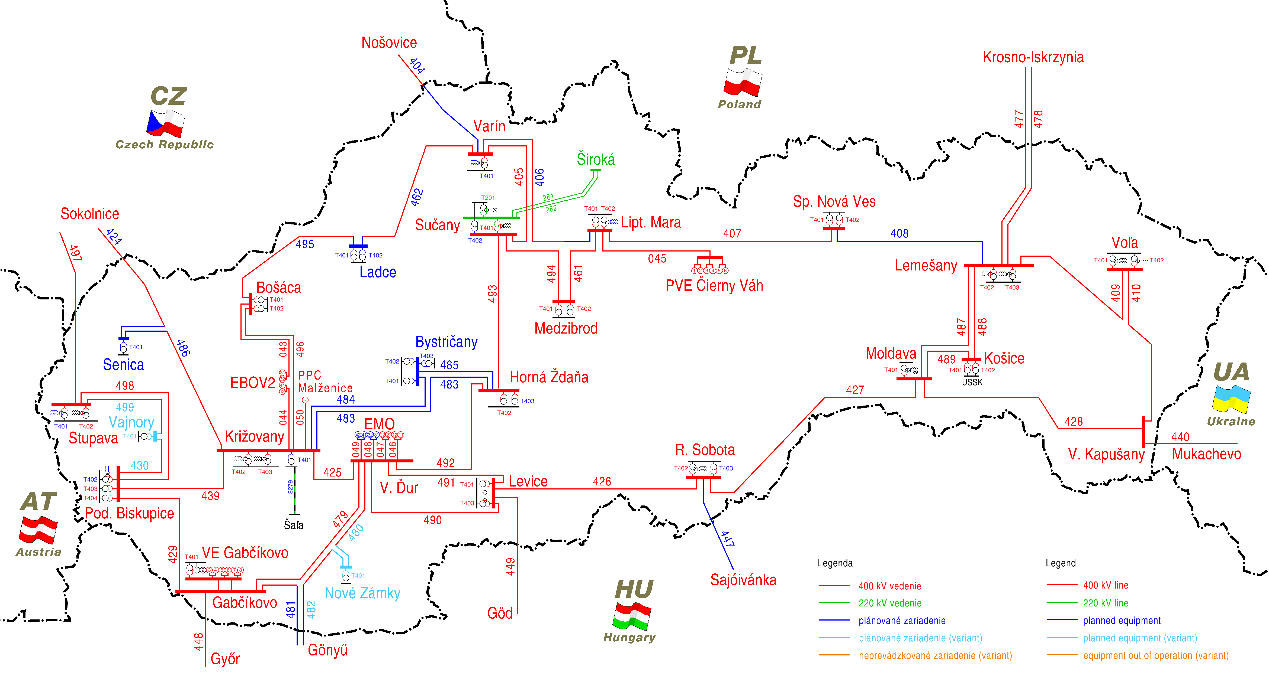
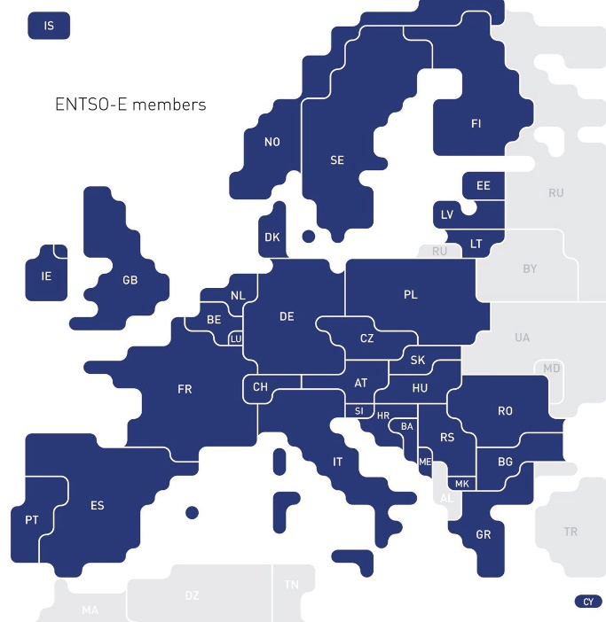
Slovak transmission system in future
Continues Capacity Increase:
In internal grid (lines, transformers)
On the borders (SK-HU profiles, EXP CAP ↑85%
IMP CAP ↑47% )

Slide 9
Thank you for your attention
Renewable Energies in Slovakia - Opportunities and Challenges ahead │ 15 October 2020│ Online Conference
Karol Kósa
Executive Director of the Electricity System Development
Slovenská elektrizačná prenosová sústava, a.s.

